Slide 1
Learning Session 2
Overview of ‘I’(improve) from the D-M-A-I-C Model

Slide 2

The presence of the Laboratory African Regional Collaboration (LARC) logo on slides
indicates that content (in whole or in part) originates with the LARC Program

Slide 3
IMPROVE
LARC Workbook, p. 63-76
https://www.larccqi.org/uploads/resources/LARC-3.0-WORKBOOK.pdf
LARC Workbook

Slide 4
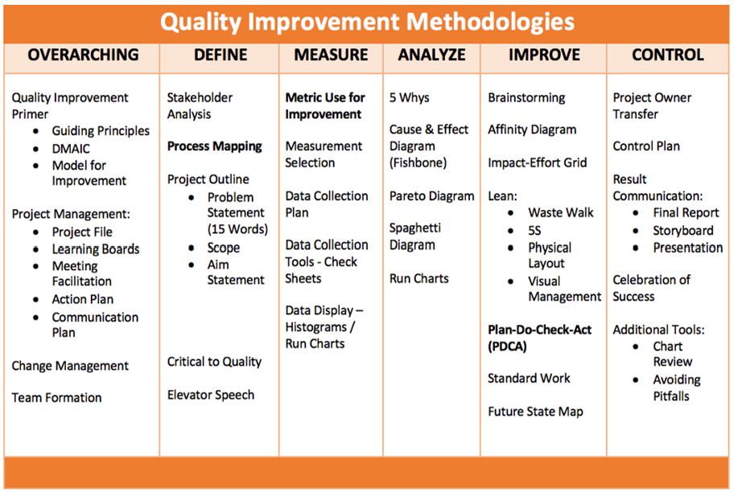
LARC Workbook

Slide 5
Overview of CLICQ! Learning Sessions
DiCE Entry Assessments | Learning Session 1 |  | Learning Session 2
Facility Tour Data Abstraction Data Entry Data Analysis Site Report Writing Site Debrief | CLICQ! Overview CQI Overview Process Mapping Overview Process map activity Walk the process Update process maps Opportunities for Improvement Impact / Effort grid DMAIC Overview DEFINE / MEASURE Project Outline Problem Statement Scope Aim Statement / Metric | Action Plan Communication Plan Data/Measurement ANALYZE ‘Fishbone’ activity 5 Whys, Cause & Effect Diagram, Pareto Diagram, Run Charts/Control Charts | CQI Revisited DMAIC Revisited Facility Presentations IMPROVE Simulation Before/After PDSA / Small Test of Change Lean 5S Visual Management Physical Layout Standardized Work | Data Display Creating a ‘Run Chart’ CONTROL Control Plan Result Communication Final Report Storyboard Presentation Spread Best Practices Celebrate Success Additional Tools Chart Review Avoiding Pitfalls
LARC Workbook

Slide 6
For Learning Session 2
Simulation – Before & After
PDCA
LEAN
Standard Work
Future State Map
Data Display
LARC Workbook

Slide 7
Project Deliverables
Learning Session 1
DEFINE / MEASURE / ANALYZE
Learning Session 2
IMPROVE / CONTROL
Identify Stakeholders
Team Formation
Map the Process (Current)
Identify/Prioritize Opportunities
  Project Outline
Baseline Metrics - Data Collection Tool/Plan
Action Plan
Elevator Speech
Root Cause Analysis
1 Rapid/Small Test of Change (PDSA)
Presentation
  Update Project Outline, if necessary
1 5S Exercise
1 Visual Management Application
2 or more Tests of Change (PDSA)
Select and Implement Change
Modify Solution(s) where necessary by additional Test of Change (PDSA)
Create Future State Map
Create Standard Work
Presentation
LARC Workbook

Slide 8
Project Deliverables
Learning Session 2
IMPROVE
Update Project Outline, if necessary
1 5S Exercise
1 Visual Management Application
2 or more Tests of Change (PDSA)
  Select and Implement Change
Modify Solution(s) where necessary by additional Test of Change (PDSA)
Data Display
Create Future State Map
Create Standard Work
Presentation
LARC Workbook

Slide 9
simulation
/sɪmjuːˈleɪʃ(ə)n/
Noun
imitation of a situation or process
the action of pretending
LARC Workbook

Slide 10
Activity
Conduct an Emergency Department Simulation: Provide “care” to your “patients” given your current environment – NO CHANGES ALLOWED
Follow Work Instructions
Goal: “Treat” as many patients as possible in the time given (30 MIN)
Debrief with the group
What you will need:
Workstations
Tabletop signs
Work instructions
Patients
Timer
Registers
Paper sheets
Flip chart
Markers
30 minutes
LARC Workbook
Notes:
ROOM SET UP
Set up room with 1, 2, or 3 simulations, 8 workstations each. Identify workstations with tabletop signs
With the first run of the simulation set up the workflow to be as difficult as possible, i.e. Place workstations not in order of numbers, 1 and 8 furthest apart, etc.
Put all supplies (DOTS) in storeroom
Put all patients (white sheets with open circles) in the waiting room

Slide 11
Work Instructions
Patients must be cared for in sequence. To assure proper and equitable care and they can not by-pass processes or be cared for out of order. Sheet of paper will be used by service provider to document services given to patients.
Patients must be cared for properly with safety and quality in mind.
Patients must be escorted from the waiting room and between all processes. When you have completed your care-giving responsibilities, call for escort to move the patients to the next process
Quality Assurance will evaluate each patient after they have been discharged to assure that the patient has received quality care. QA will track the Quality measures and the throughput time (time from start until patients completes treatment).
No process changes are allowed during this round as we want to understand and baseline the current process.
Run for 30 minutes. When time is up, STOP and STEP AWAY from your patients.
LARC Workbook
Notes:
Feed back from audience Present work instructions – just read as written, provide no emphasis

Slide 12
The ED or ER Simulation – Team Roles
We need:
1 Volunteer → Quick Registration
1 Volunteer → Triage
1 Volunteer → Full Registration
1 Volunteer → Treatment
1 Volunteer → Discharge
1 Volunteer → Quality Assurance
1 Volunteer → Transport
1 Volunteer → Supplies
1 Volunteer → Transport Spaghetti Map (optional)
LARC Workbook
Notes:
Say: Here are the roles for our ER exercise. Transport people should proceed to the waiting room and Supplies personnel should report to the Store Room (location of dots).
You will need a minimum of 8 people per “team” . You may add the optional volunteer to develop a spaghetti map of the transport person route for the 5 minute exercise (9 people total) or an optional volunteer to distract the caregivers (10 people) or an optional volunteer to time the activity (11 persons)
Maximum of 3 teams. Decide on # of teams based on class size and layout of room. 1 team for class size of 15 or less. (You will have a few observers, but have them write down issues that stood out to them). 2 teams for class size of 16 to 23. 3 teams for class size 24 to 30.
When running multiple teams, make sure teams can identify their “teammates”.

Slide 13
Metrics
TEAM | # of Patients Treated (Completed) | # Treated “Correctly” | # Patients in Process | Time to First Patient Completed
1
2
3
LARC Workbook

Slide 14
Debrief (Important Part of PDSA)
How did it feel?
  to be the triage person? transport person? supply person?
What was the teamwork and communication like?
How do you think the patients felt?
What about the metrics?
How did we define Quality?
  Anyone notice there were dots outside of the circle?
  What did you do when you saw a quality issue?
  How was the training and instructions?
Act
Plan
Study
Do
LARC Workbook
Notes:
Ask patient volunteers how they felt. Were they satisfied

Slide 15
This simulation will be repeated at the end of the day. The tools learnt today will help you improve your process for a better patient outcome.
What will you do for your next PDSA?
  What are three options for your next PDSA?
LARC Workbook
Notes:
Answer: In IHI Course QI 103 - Adjust, Adopt or Discard

Slide 16
The Model for Improvement
3 Questions
PDSA
LARC Workbook, p. 8-12
https://www.larccqi.org/uploads/resources/LARC-3.0-WORKBOOK.pdf
LARC Workbook

Slide 17
The Model for Improvement (IHI)
Aim
What are we trying to accomplish?
Measure
How will we know that a change is
an improvement?
Change
What change can we make that
will result in improvement?
Small tests of change
Act
Plan
Study
Do
LARC Workbook, p. 8-9
https://www.larccqi.org/uploads/resources/LARC-3.0-WORKBOOK.pdf
LARC Workbook
Notes:
Improvement techniques are Formal methods to test changes in the steps of a process and seek to achieve greater process reliability more efficiently and at less cost
- Best to use an example like weight loss
- Reliable Process-a set of steps that when performed achieves the same result with minimum variation over time. The likelihood that a process will achieve its desired outcome is dependent on the variability of each step and the total number of steps. Reliability goes down as the number of steps increase and as the variability of the steps increases
- Test of Changes
- A test of change alters a step in a process and evaluates the impact of that alteration
- There are 3 questions to ask prior to a test of change or Plan, Do, Study Act PDSA
What are we trying to accomplish?
How will we know that a change is an improvement?
What change can we make that will result in improvements?
- PDSA’s don’t result in success or failure, they generate learning
- 4 components of PDSA
- Plan-develop an action plan to run the cycle. Predict the expected result. The who, what, where, and when. Keep it simple, only one change at a time, one shift, one day, etc.
- Do-perform the action plan
- Study-evaluate the change, and whether it performed as predicted
- Act-Reflect on what happened and use the learning to begin planning for the next test of change
- How to determine what test of changes to do
- First have a clear Aim, which means the team knows what to work towards
- Reflect on the major factors or drivers that will influence achieving the goal. This helps to focus the group’s efforts and decreases the likelihood that unnecessary work will occur
- Determining the major factors or drivers helps to limit the interventions or actions to the few that are most likely to help achieve the goal.
Plan
State the objective of the cycle, what are we trying to accomplish?
Make predictions
Generate solutions
Develop the plan to carry out the cycle (who, what, where, when)
Do
Test the change
Document problems and unexpected observations
Analysis the data
Study
Complete the analysis
Compare the data to predictions
Summarize learning's
Act
Make changes to the process
Standardize the process
Select the next cycle
What change can we make that will result in improvement?

Slide 18
The Model for Improvement
What are we trying to accomplish? | How will we know if a change is an improvement? | What change will we make that will result in an improvement?
Overarching Goal Improve the care & management of TB patients. Improve result reporting/treatment initiation step of the TB/HIV cascade | AIM Statement Increase the percentage of TB results released to DOTS clinic and placed on treatment from 12% to 50% by 15 July (Short-term aim) from 50% to 80% by 15 August (Long-term aim) Metric: # patients placed on treatment # Positive TB results in clinic | NEW LOG / NEW PROCESS Track documentation and actions related to release of TB Test Results Appropriate Treatment for Patients
LARC Workbook

Slide 19
Test of Change = PDSA
A test of change alters a step in a process and evaluates the impact of that alteration
LARC Workbook, p. 10-12
https://www.larccqi.org/uploads/resources/LARC-3.0-WORKBOOK.pdf
LARC Workbook

Slide 20
PDSA: The Scientific Method of Improvement
The Scientific Method
  Create a hypothesis
  Perform an experiment
  Analyze the results
  Draw conclusions
Act
Plan
Study
Do
LARC Workbook
Notes:
Ask patient volunteers how they felt. Were they satisfied

Slide 21
Discovery of the Structure of DNA
Hypothesis: Linus Pauling, Francis Crick and James D. Watson hypothesized that DNA had a helical structure.[
^{41]}
Prediction: If DNA had a helical structure, its X-ray diffraction pattern would be X-shaped.^{[42][43]} This prediction was determined using the mathematics of the helix transform, which had been derived by Cochran, Crick and Vand^{[44]} (and independently by Stokes). This prediction was a mathematical construct, completely independent from the biological problem at hand.
Experiment: Rosalind Franklin crystallized pure DNA and performed X-ray diffraction to produce photo 51. The results showed an X-shape.
Analysis: When Watson saw the detailed diffraction pattern, he immediately recognized it as a helix.
LARC Workbook

Slide 22
Selecting the Change…
How to determine which tests of change to do
CHANGE
Have a
Clear Aim
Understand Root Cause
Research
(Evidence-based changes)
Brainstorm
Experience
Listen to Voice of Customer
LARC Workbook
Notes:
- How to determine what test of changes to do
- First have a clear Aim, which means the team knows what to work towards
- Reflect on the major factors or drivers that will influence achieving the goal. This helps to focus the group’s efforts and decreases the likelihood that unnecessary work will occur
- Determining the major factors or drivers helps to limit the interventions or actions to the few that are most likely to help achieve the goal.

Slide 23
CHECK Learning Session 1: PDSA - Small Test of Change
ACT
PLAN
DO
CHECK
Increase # of presumptive TB patients with specimen collected from ___ to 95%
Worked well → Standardize
Did not work → Create new test of change (PDCA)
Worked partially → “Tweak” and begin PDCA #2
Analyze Data (by 29 July)
  Met goal?
  Why/Why not?
Implement patient escorts from the ART and OPD clinics to the DOTS clinic.
Tracking log every Sunday.
LARC Workbook
Notes:
Adapt, Alter or Abandon
3 Basic PDSA Principles
Test on a small scale and build knowledge sequentially
Collect data over time and display it
Include a wide range of conditions in latter test cycles

Slide 24
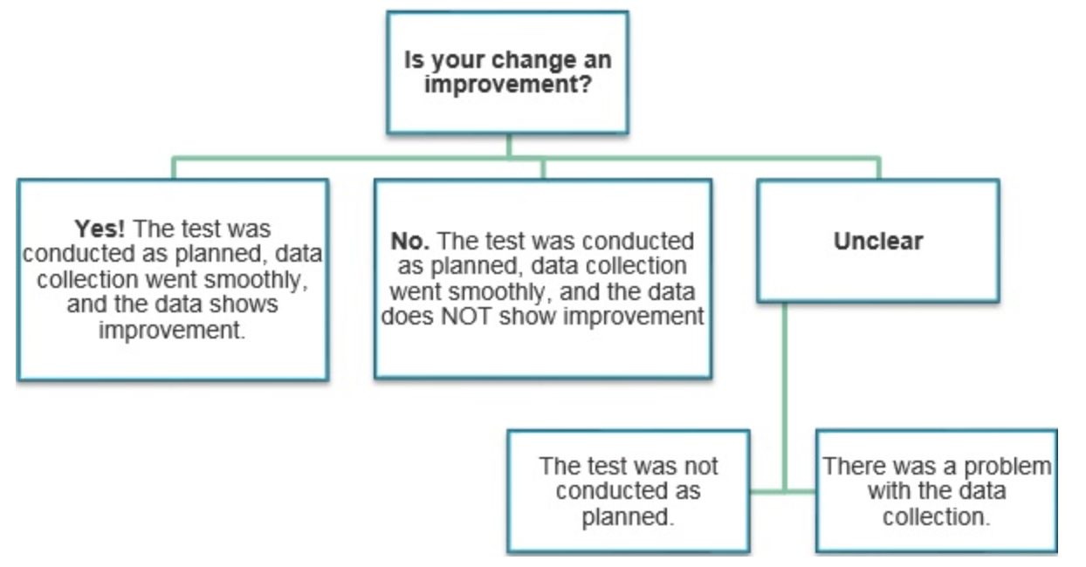
Evaluating PDSAs
LARC Workbook

Slide 25
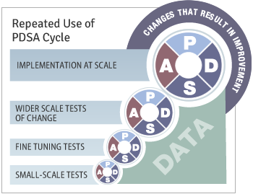
PDSA – Not one and done!
LARC Workbook

Slide 26
LEAN
Eliminate Waste
LARC Workbook, p. 68-75
https://www.larccqi.org/uploads/resources/LARC-3.0-WORKBOOK.pdf
LARC Workbook
Notes:
Like its name sounds, it’s a way to slim down our processes by eliminating waste, variation and imbalance
Note examples of waste, variation and imbalance in the recent exercise.
Our goal is to create value end to end in the process.
Lean - Improving Workflow,
Removing Non-Value Added Aspects
Lean and Six Sigma are complementary philosophies.
The difference in lean and Six Sigma lie primarily in the focus. The elimination of waste with lean is fairly similar to the reduction of variation in Six Sigma. However, leans focus on improving workflow is perhaps the main differentiator. By focusing on the workflow, lean efforts ensure that non-value-adding aspects are removed from the value stream.
Lean efforts help make sure that we are doing the right things. Six sigma initiatives help make sure we are doing the right things right.
Lean: Background
Lean: Background
•
1913: Henry Ford’s breakthrough thinking
•
1942: Training within industry (war effort)
•
1947-80: Toyota Production System
•
1990: Term coined in 1990 best-seller The
Machine That Changed The World
(author = Womack)
•
2000: Lean Enterprise, Service &
Health Care
•
Lean Thinking
Principles
1. Define value from perspective of end
customer
2. Identify the value stream(s) and highlight
waste
3. Understand what drives the waste
4. Eliminate all the waste that one can
5. Make the remaining value-creating steps flow
6. Pursue perfection
Lean works in
all industries, all functions, anywhere
there is an activity
.

Slide 27
Lean Simplified
Streamline the Value Stream (Workflows & Layouts)
Workplace organization (5S)
Predictability & Consistency (Quality) – e.g., Mistake Proofing
Visual Workplace
Continuous Improvement (PDCA)
Pull vs Push
LARC Workbook

Slide 28
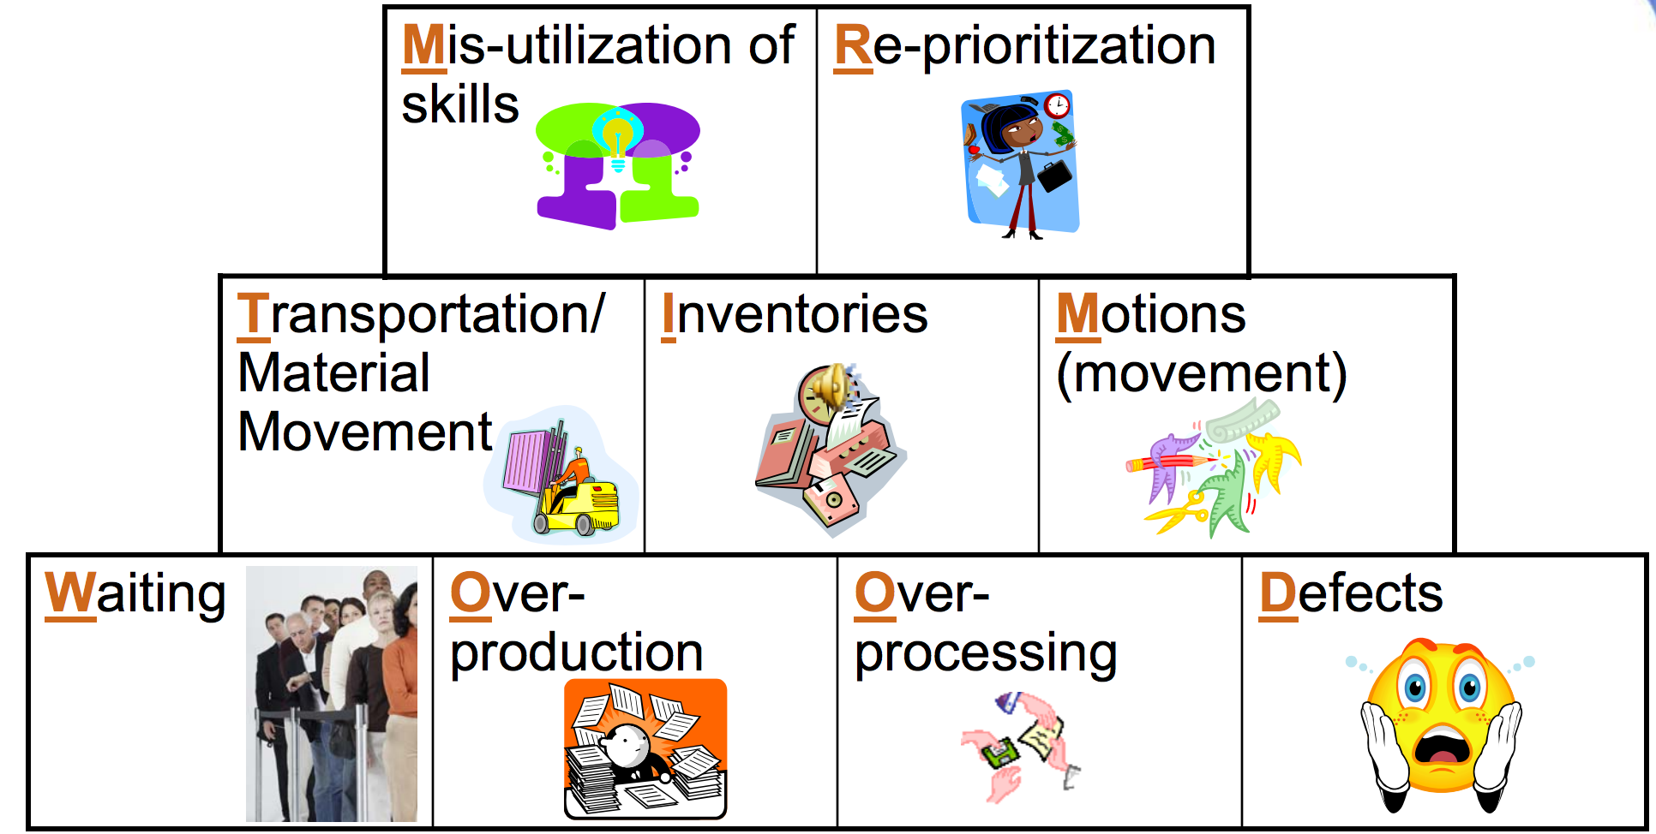
Types of Waste – MR TIM WOOD
LARC Workbook
Notes:
Elimination of waste starts with identification of waste.
Anything that does not add value is classified as waste.
Identification of waste may require a change in thinking.
Revisit the why’s of every process step. Is it really necessary?
Some activities and process outputs seem necessary to meet internal standards, but are they necessary to the external customer?
Waste can be considered as any activity or resource in an organization that does not add valued to an external customer.
M - Mis-utilization of skills: Not taking advantage of people’s expertise, improvement ideas not listened to or acted upon; Under utilizing capabilities, delegating tasks with inadequate training
R - Reprioritization: Stat orders, phone calls, trouble shooting, emails, IM pop ups
T – Transport – Moving people, products & information; Moving patient records or films to another area; going to get signatures
I – Inventory – Storing parts, pieces, documentation ahead of requirements; Pharmacy stock, lab supplies, office supplies
M – Motion – Bending, turning, reaching, lifting; Searching for patients; searching for medications, searching for charts, searching for files; moving patients for testing
W – Waiting – For parts, information, instructions, equipment; waiting for bed assignments, discharge, approvals
O – Over production – Making more than is IMMEDIATELY required; Medication given early to suit staff schedules, testing ahead of time to suit lab schedule, making extra copies
O – Over processing – Tighter tolerances or higher grade materials than are necessary; Multiple bed moves, extra paperwork, excessive reviews/analysis, creating reports no one uses/reads, use of out-dated forms
D – Defects – Rework, scrap, incorrect documentation; Medication errors, improper diagnosis, patient complaints, data entry error, pricing error, mislabeled specimen.

Slide 29
Activity
What you will need:
Sticky notes
Markers
Conduct a “Waste Walk”: Identify the Waste in the ER Exercise
Using the 9 categories of waste as a guide, write (sticky notes) the specific episodes of waste that you experienced during the ER exercise
Place on flip chart - under appropriate categories
Debrief with the Group
7 minutes
LARC Workbook, p. 70
https://www.larccqi.org/uploads/resources/LARC-3.0-WORKBOOK.pdf
LARC Workbook
Notes:
Say: The first and easiest Lean tool you can start using immediately is a waste walk. A waste walk is an opportunity to look at your process with a completely different perspective.
Simply stated, you observe the process while at the same time documenting any examples or occurrences of the 9 types of waste we just reviewed. The handouts contain a template for taking a waste walk.
To demonstrate, I’d like you to take 5 minutes as a table and do a mental “waste walk” based on the ER exercise you just completed for the 1st round of the Dot Exercise.
As the class is discussing, list the 9 wastes on a flip chart. After 5 minutes, poll the class for some of their responses for each type of waste and write it next to each waste category on the flip chart.

Slide 30
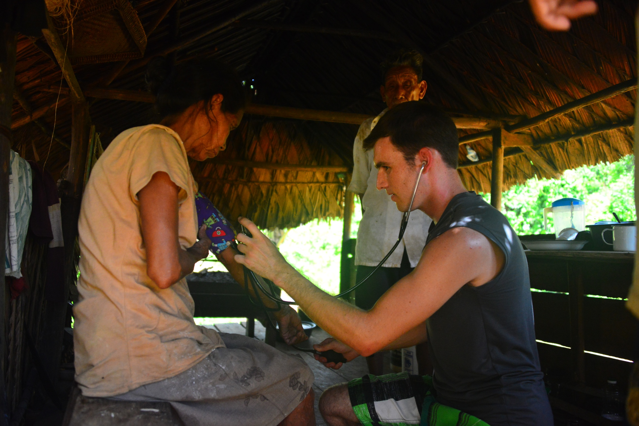
Value
Define value in your process through the eyes of the patient
LARC Workbook

Slide 31
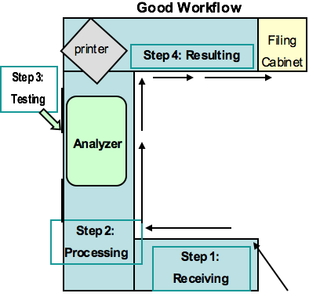
Process + Structure = Outcome
Process Flow
Layout
LARC Learning Session I PowerPoint
Notes:
Process flow and layout are at the heart of lean manufacturing.
In all cases, the flow patterns arrange the process steps in a natural flow order, link process steps to minimize cycle time and travel distance, eliminate crossover points, and simulate a continuous flow process by putting internal customers and suppliers next to each other.

Slide 32

Value-Added Ratio
Process Time (Value Added)
Total Time
LARC Workbook
Notes:
Using the ED Simulation, Calculate the value-added ratio, find the bottle neck

Slide 33
LEAN – 5S
LARC Workbook, p. 71-73
https://www.larccqi.org/uploads/resources/LARC-3.0-WORKBOOK.pdf
LARC Workbook

Slide 34
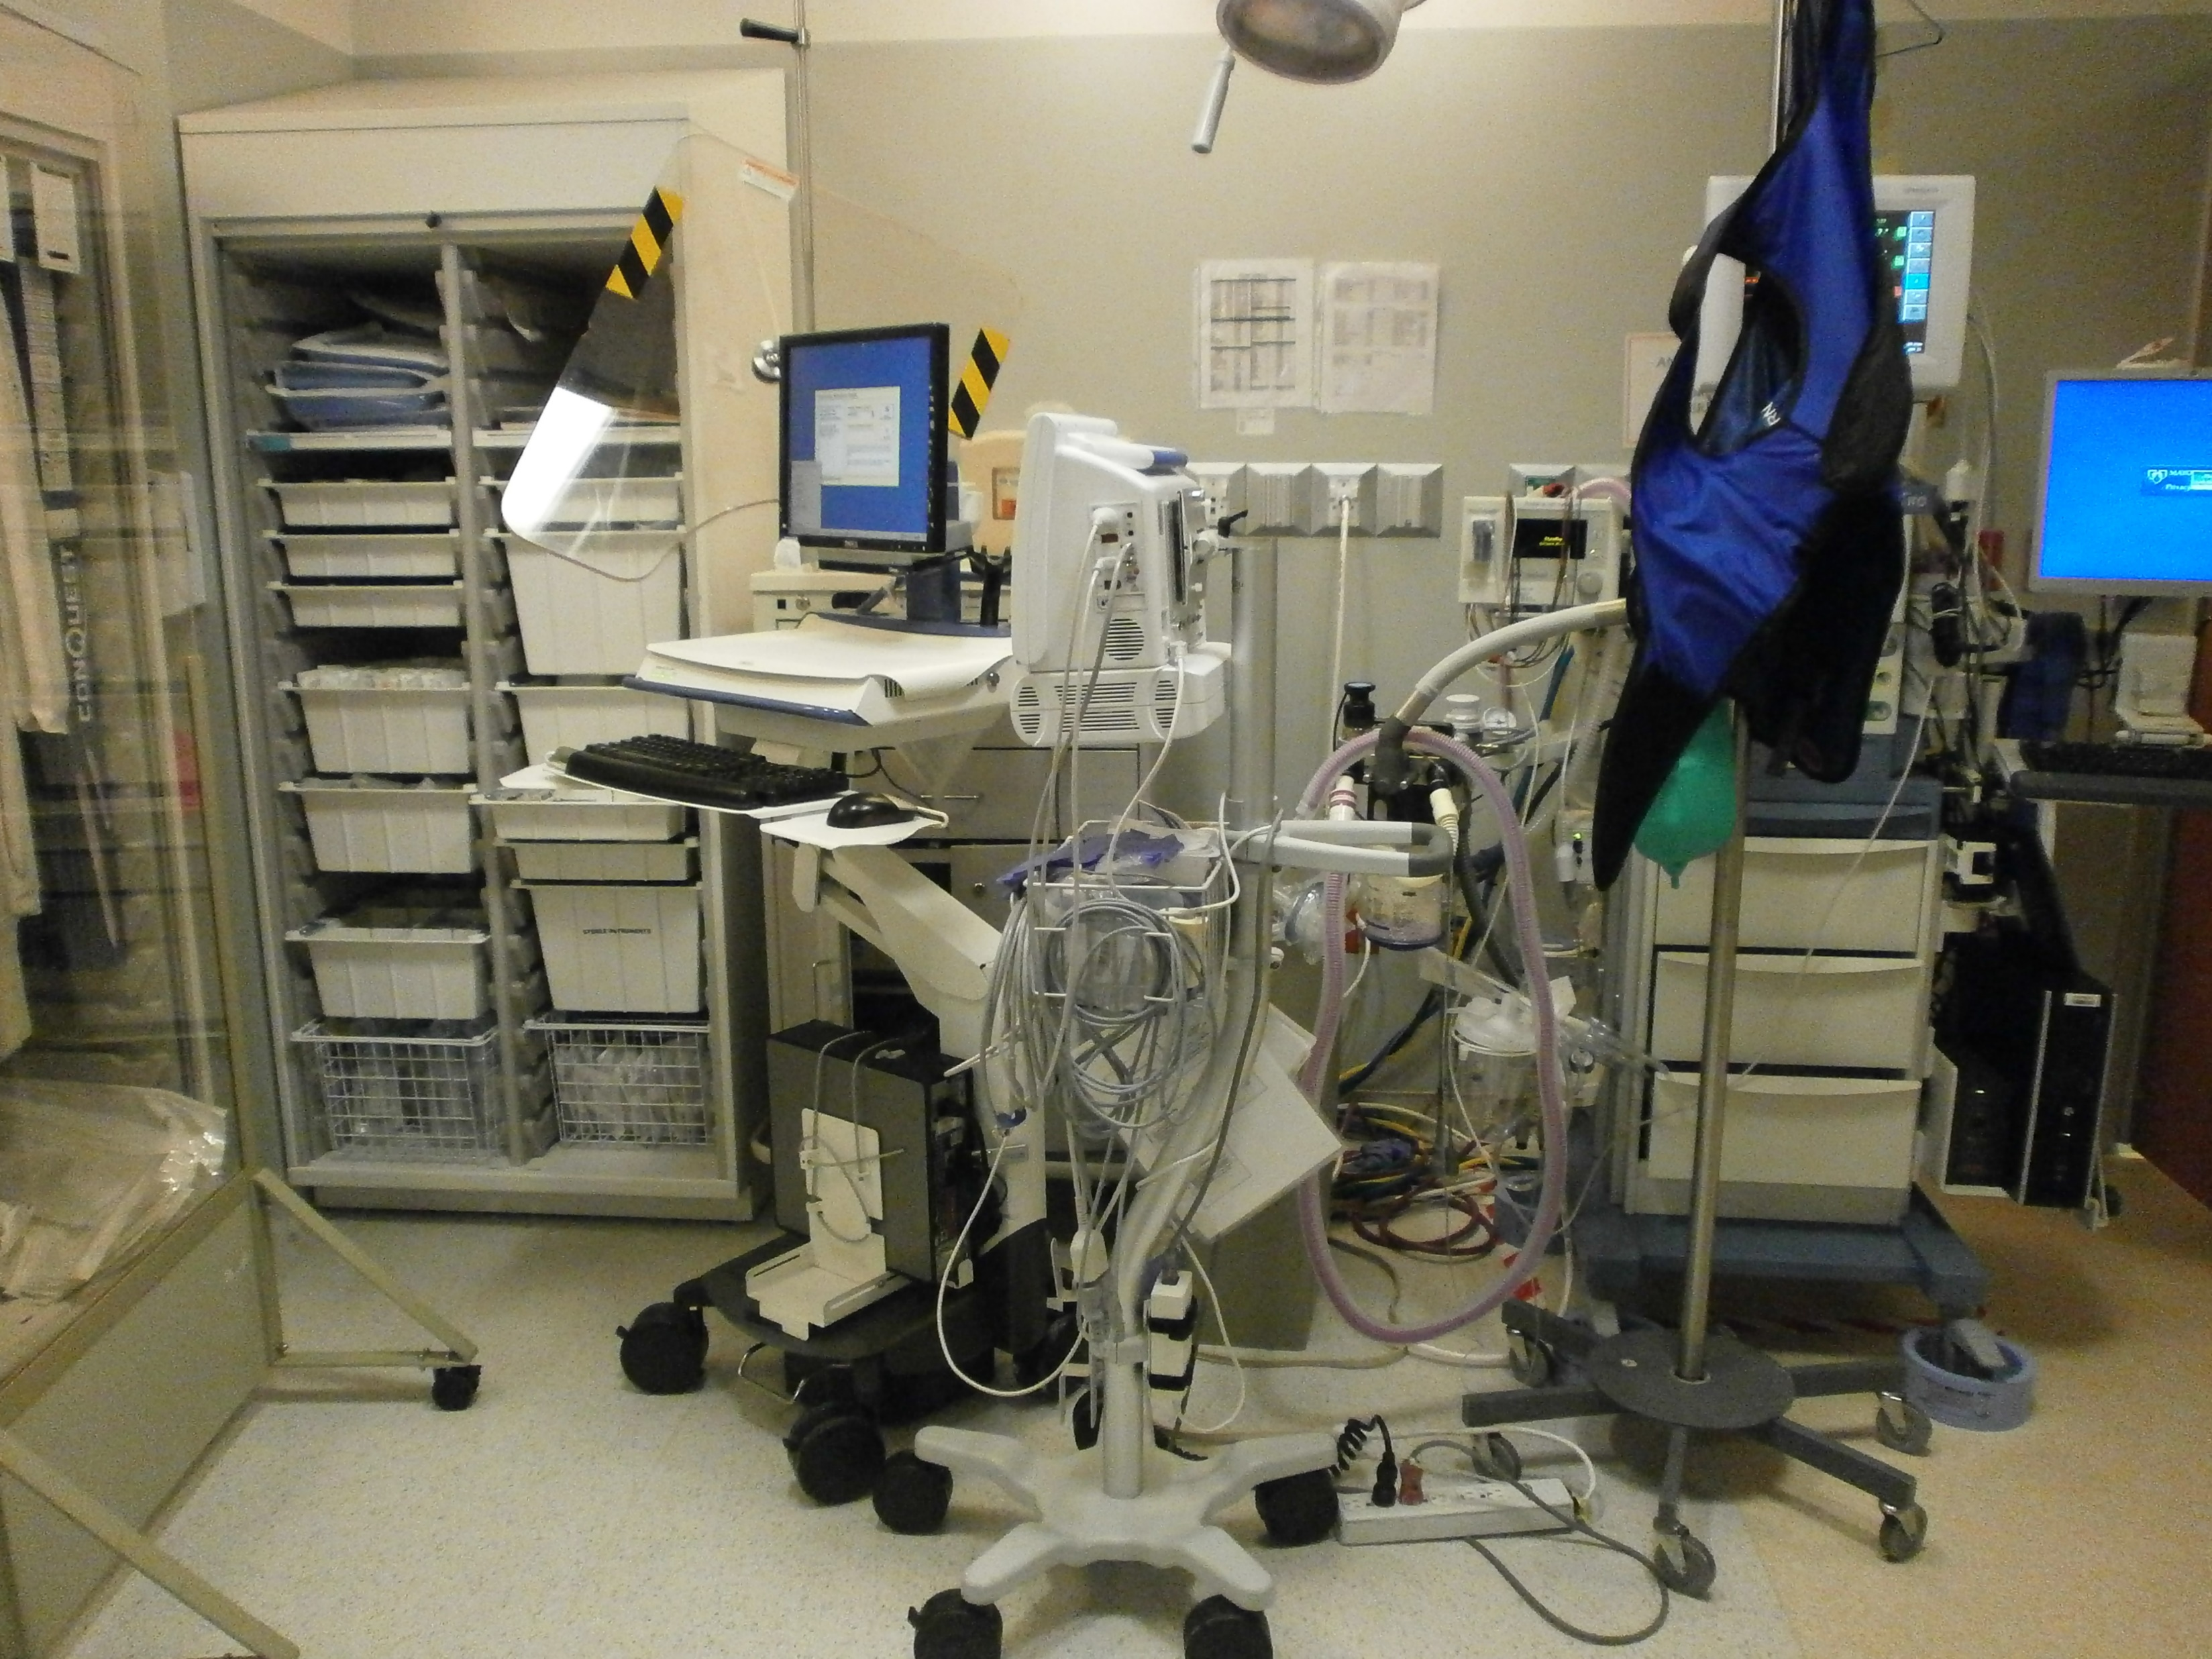
If you are here…
LARC Workbook

Slide 35
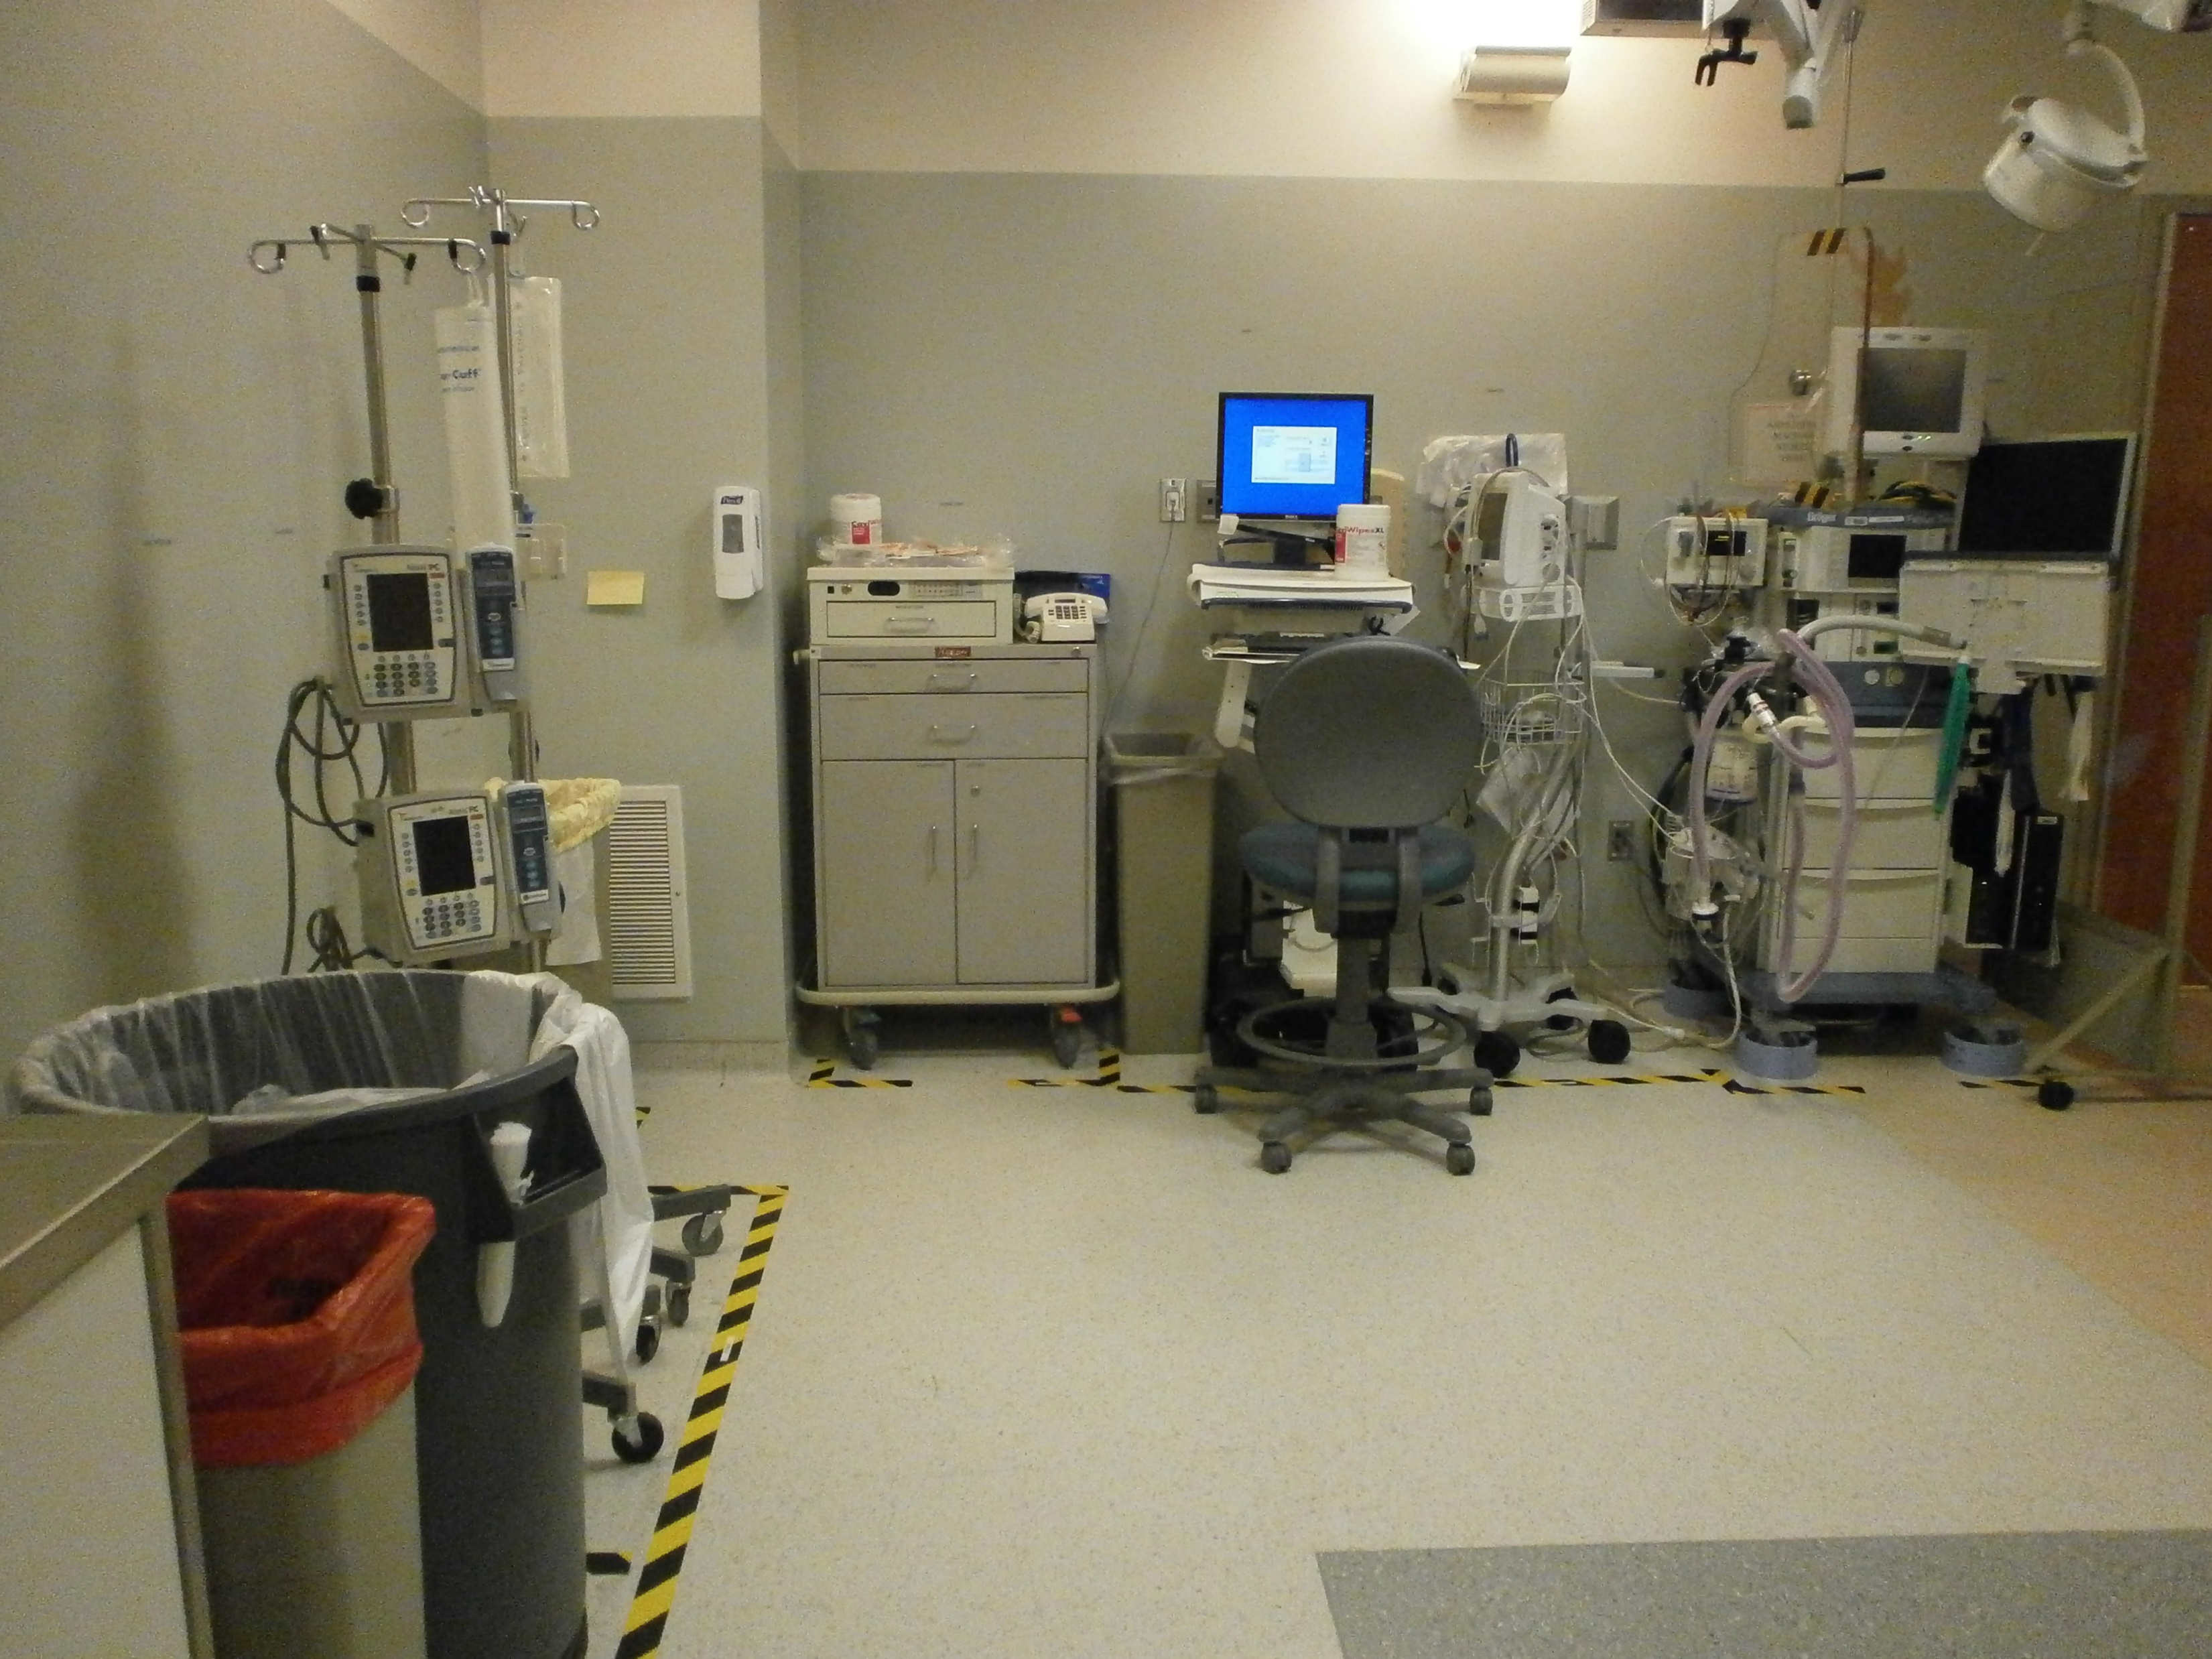
But you want to be here…
LARC Workbook

Slide 36


…then, 5S is the tool for you!
Before
After
LARC Workbook

Slide 37
5S
Sort
Needed items from the un-needed
Standardize
Consistent guidelines, visual indicators
Sustain
Education, communication, and continual improvement. Until it becomes a habit!
Set in Order
Shine
Efficient access and identification
Area is clean and everything is maintained
LARC Workbook
Notes:
Say: And here is a description of the workplace using 5S. There are 5 steps in this process.
TEST Q: Sorting through and getting rid of unneeded items (waste)
Setting what’s left in order so it can be seen and reached
Making the area clean and shiny
TEST Q: Standardization: Creating ways to do this in a standard way going forward. Taking the guess work out.
And finally…
Creating a driving force to make sure we sustain the work that was done. This is the hard part!

Slide 38
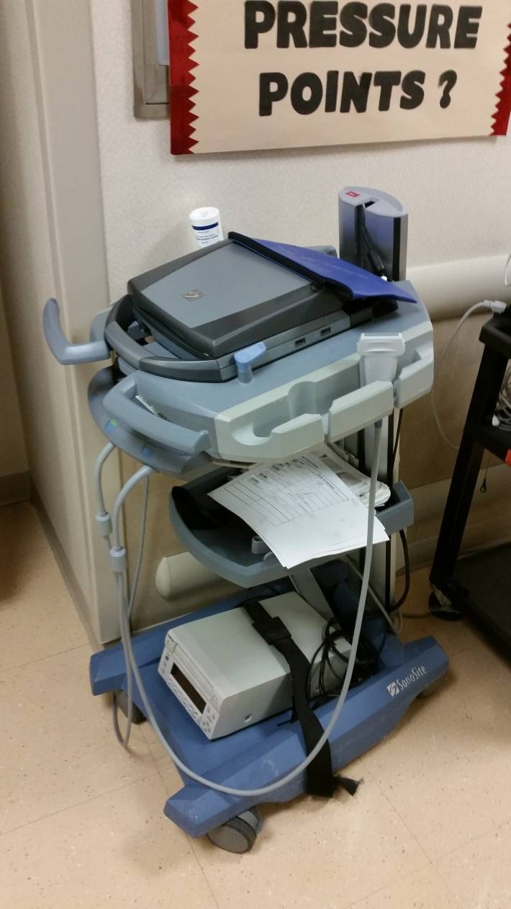
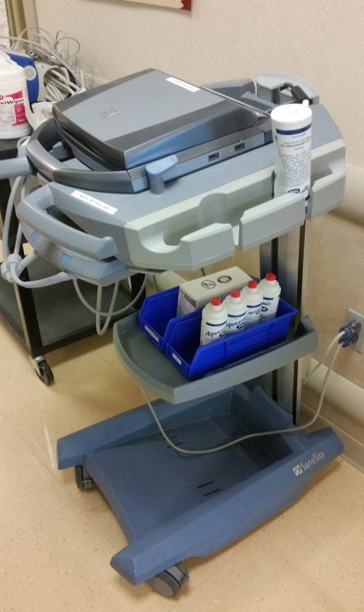
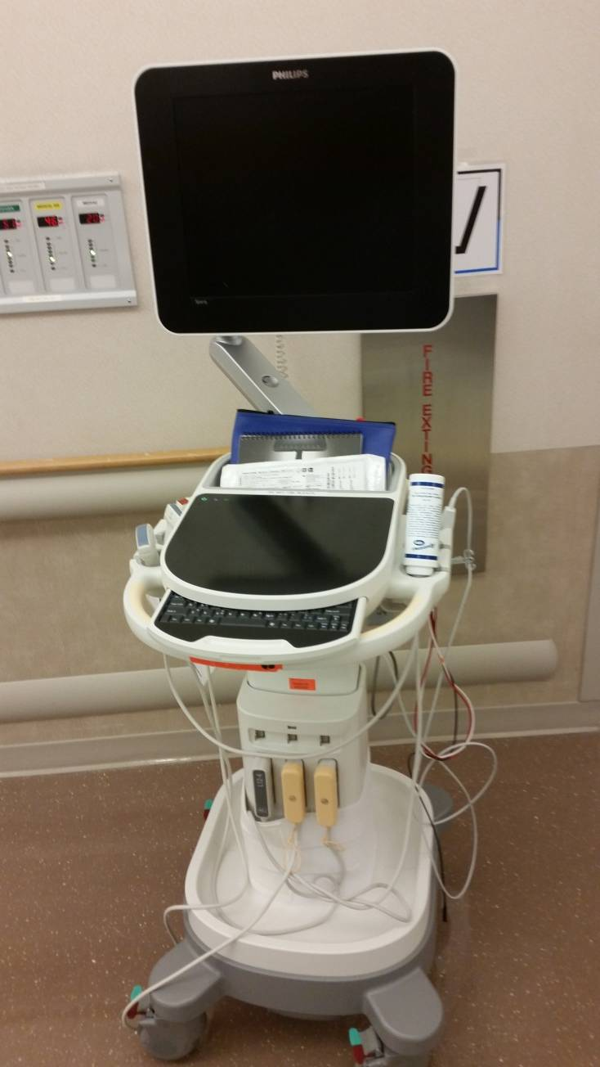
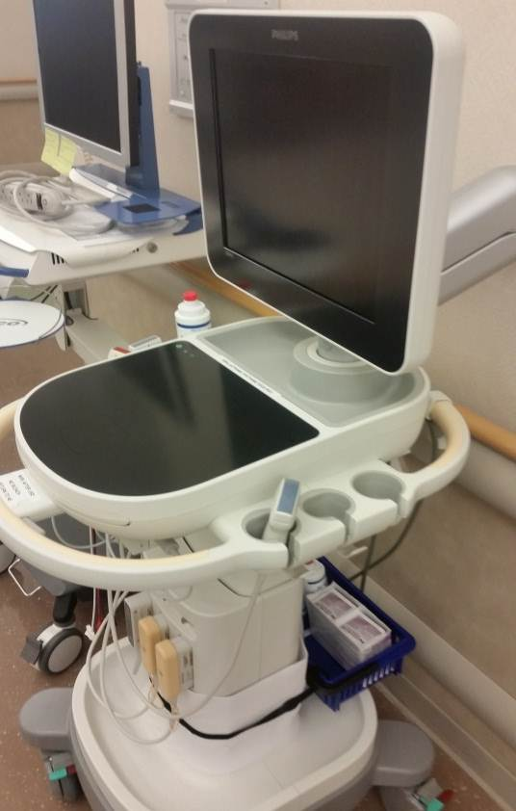
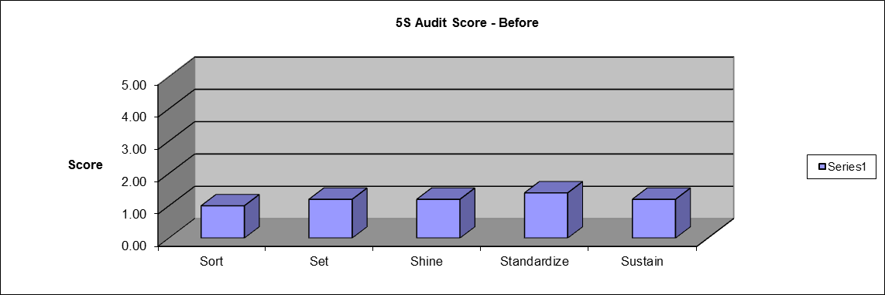
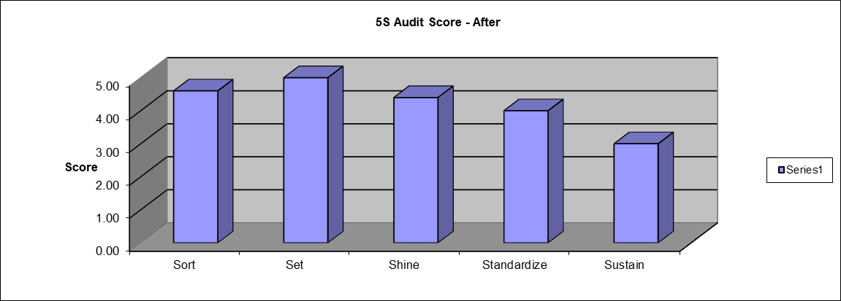

5S: Before and After Pictures
Before
After
Before
After
Before
After
LARC Workbook

Slide 39
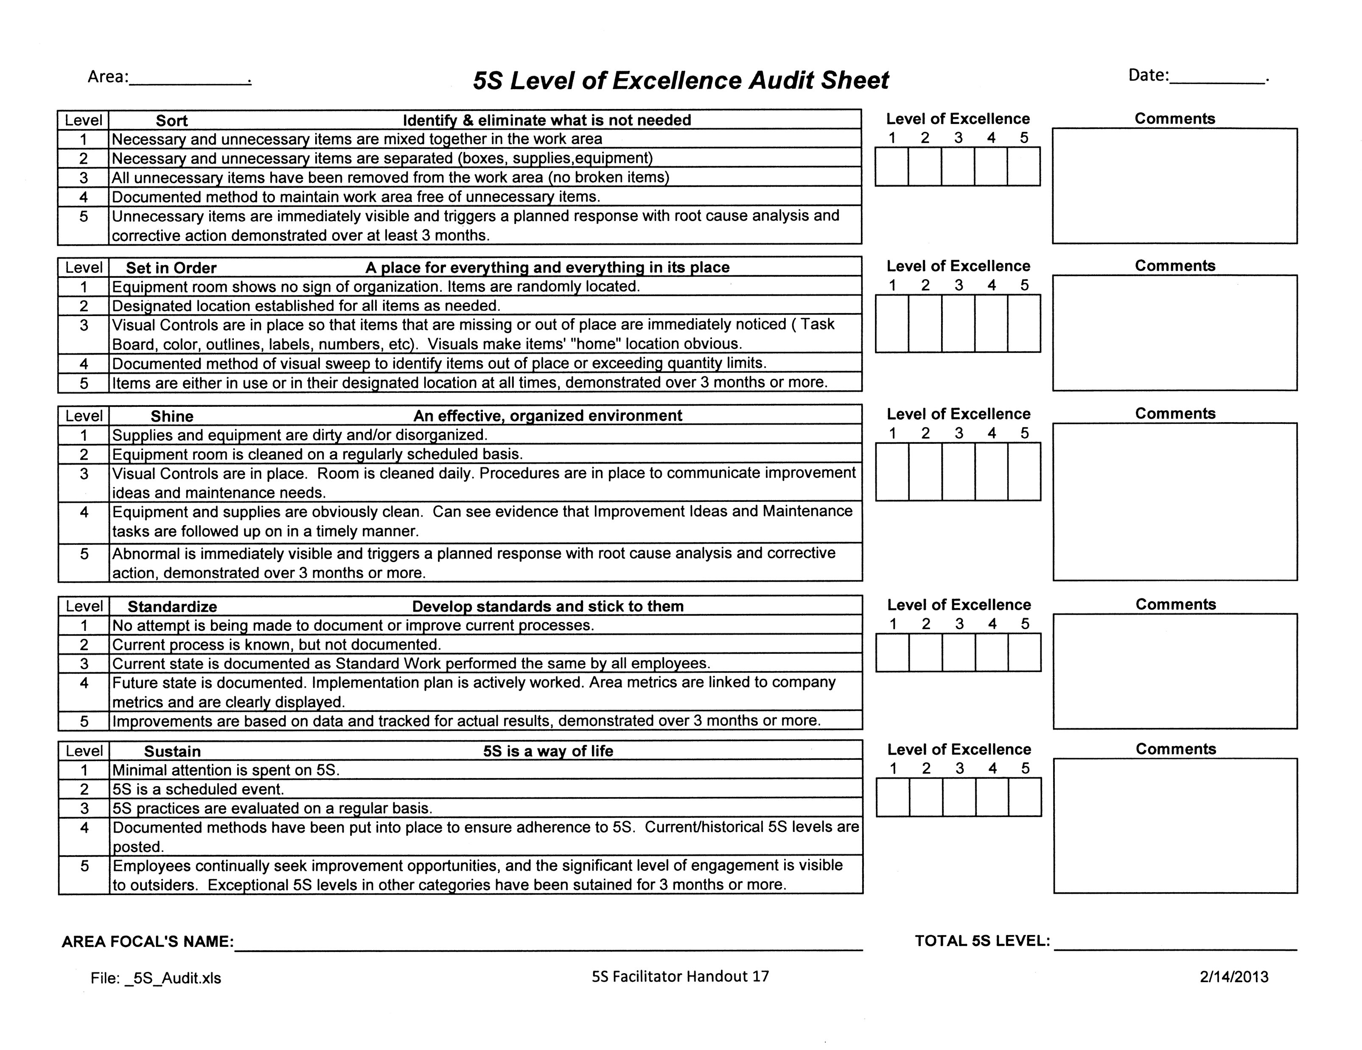
Measure
Measure
Measure
5S Audit Sheet
LARC Workbook, p. 73
https://www.larccqi.org/uploads/resources/LARC-3.0-WORKBOOK.pdf
LARC Workbook

Slide 40
LEAN - Visual Management
LARC Workbook, p. 74
https://www.larccqi.org/uploads/resources/LARC-3.0-WORKBOOK.pdf
LARC Workbook

Slide 41
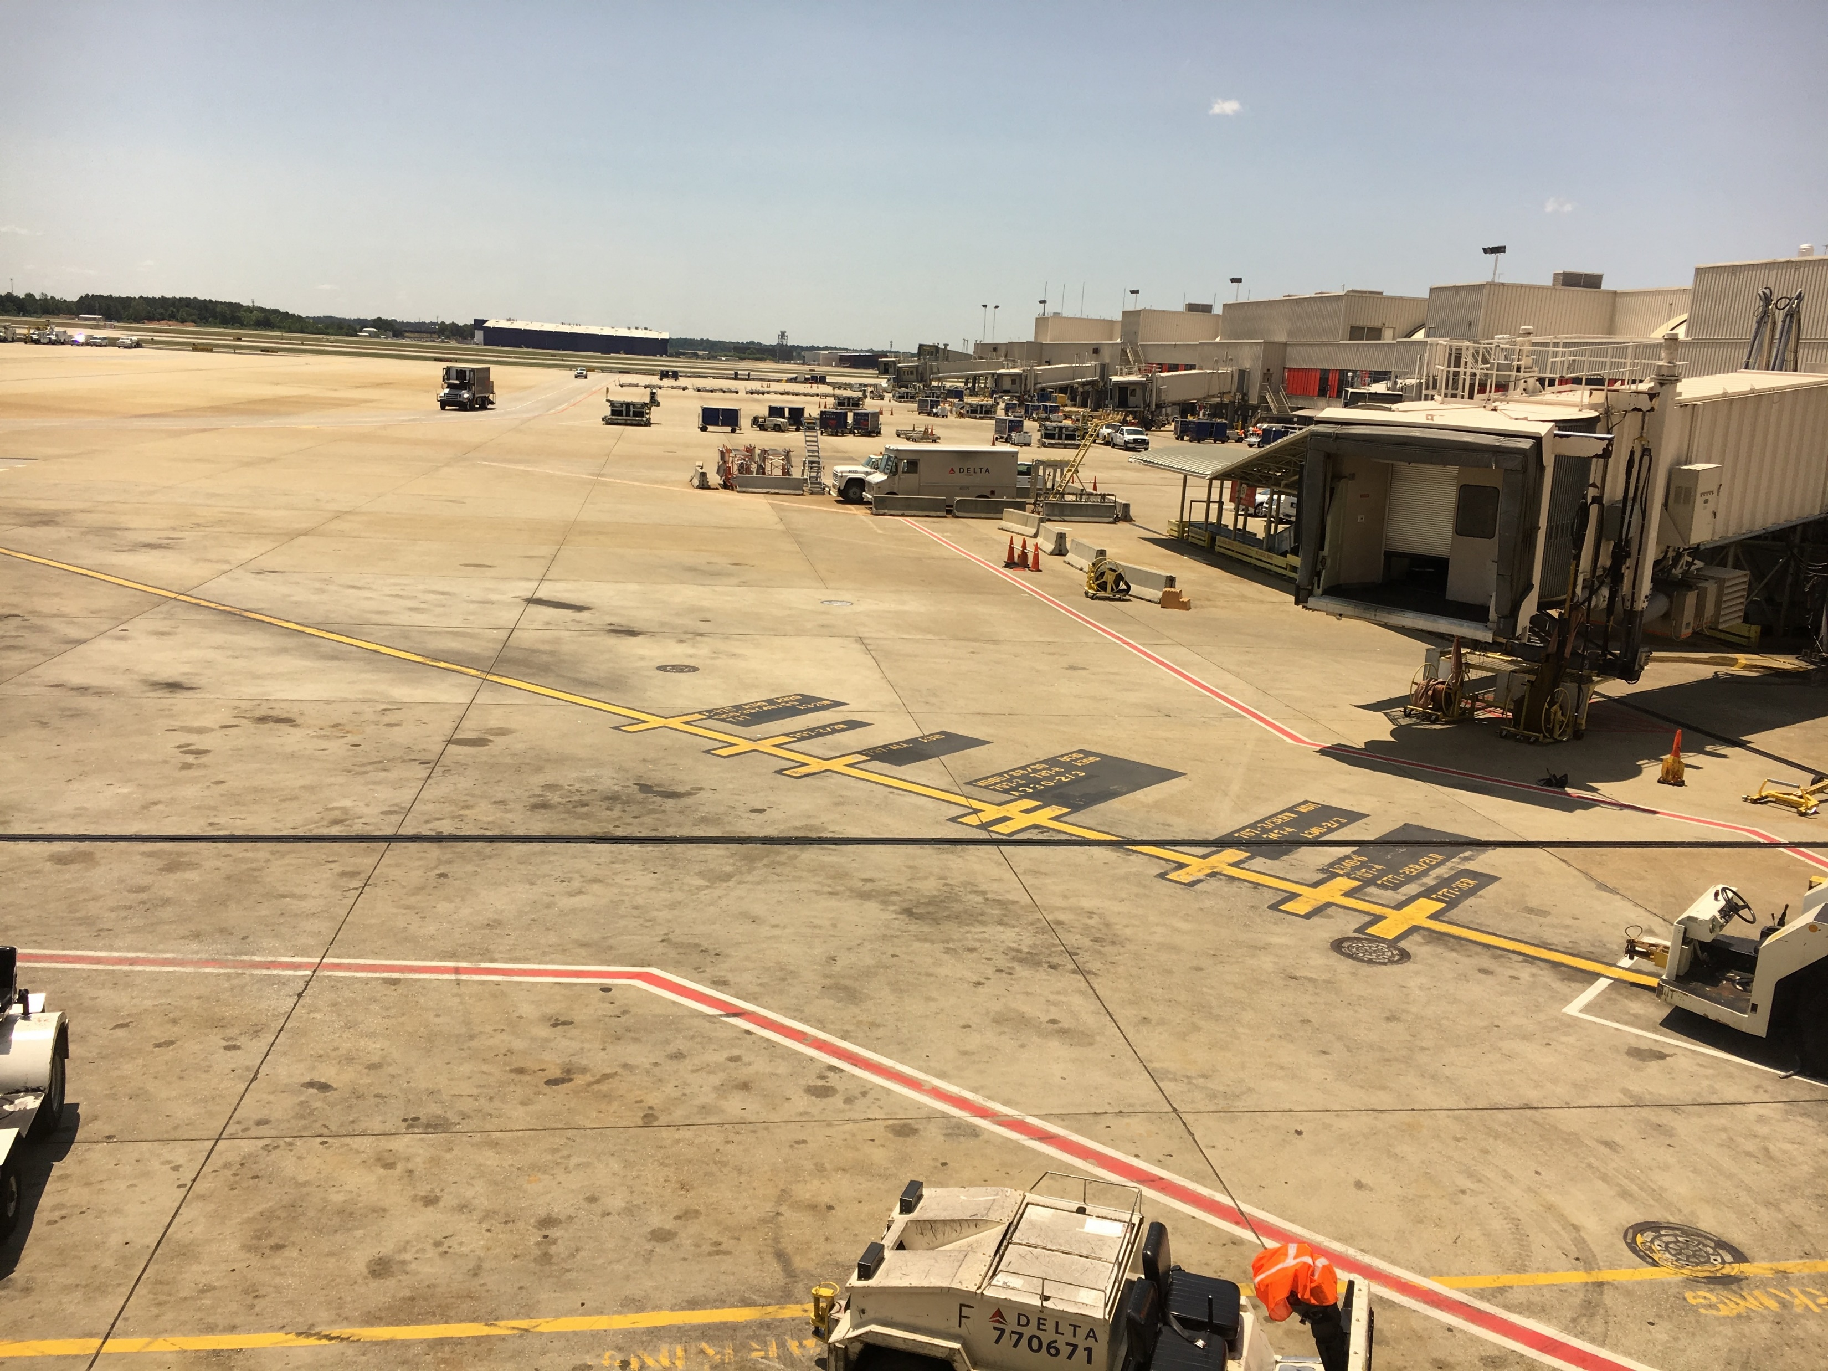
Making quality, safety, and efficiency visible & therefore, easy to do!
LARC Workbook

Slide 42
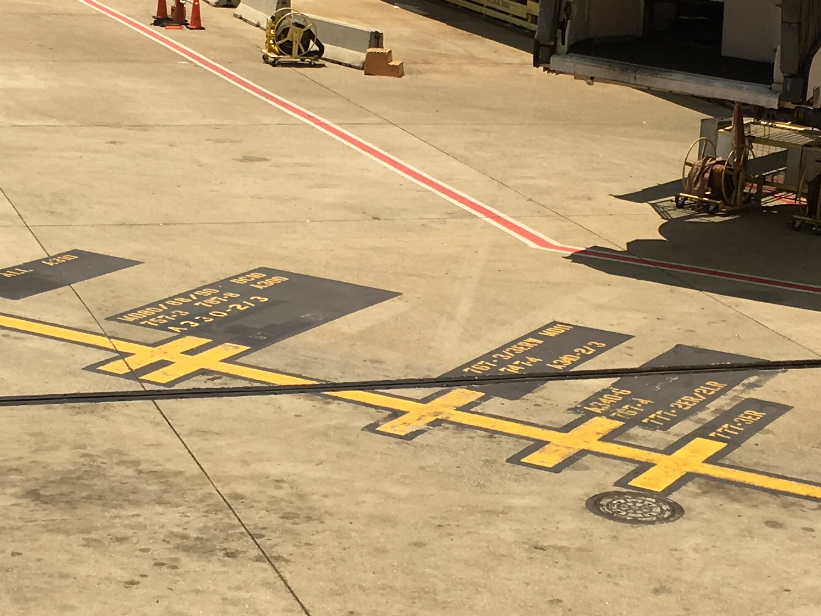
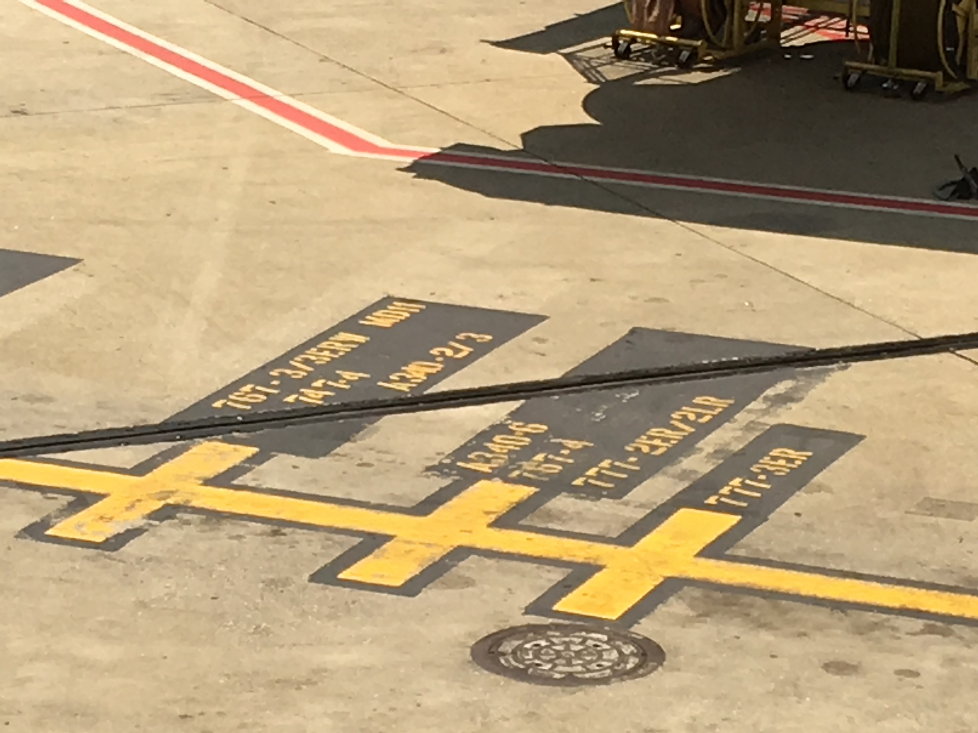
LARC Workbook

Slide 43

LARC Workbook

Slide 44
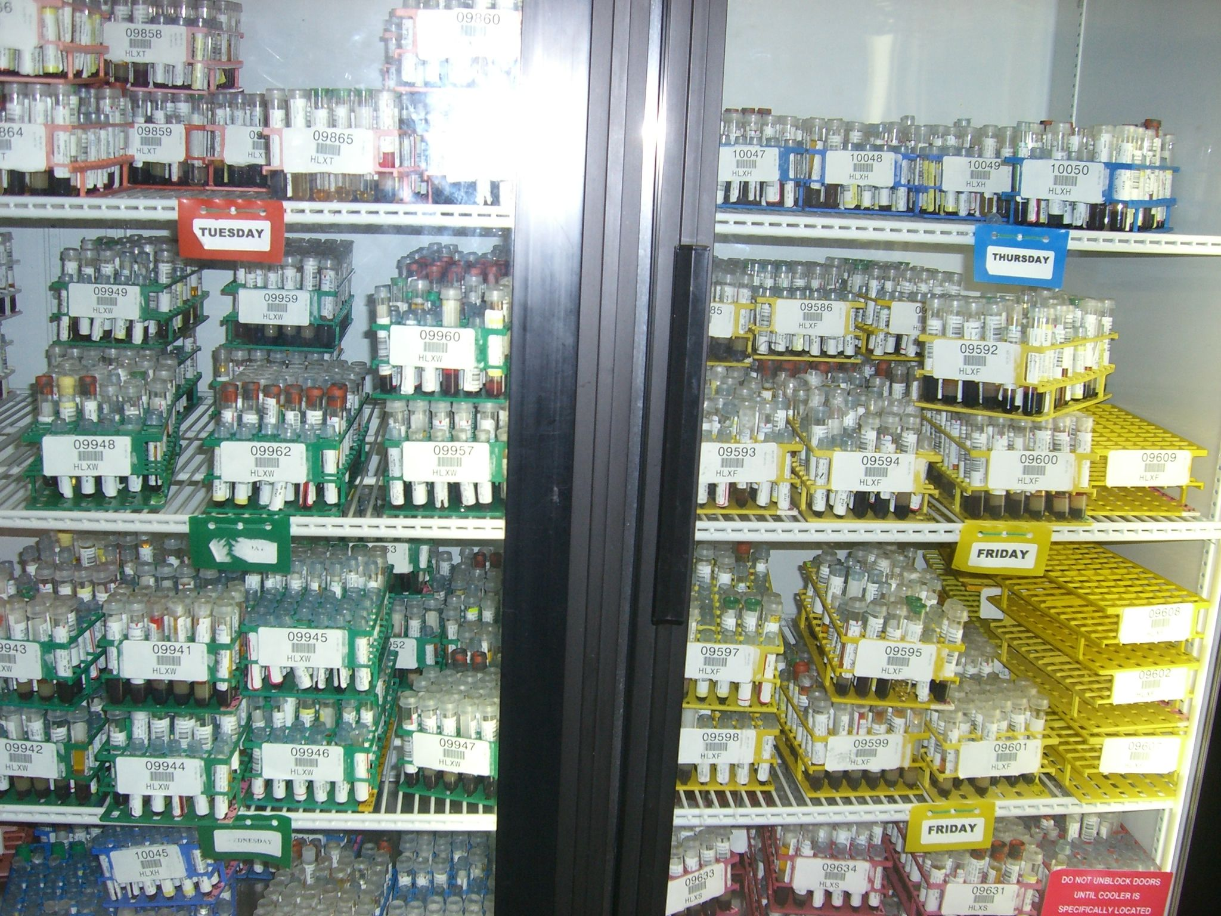
LARC Workbook

Slide 45
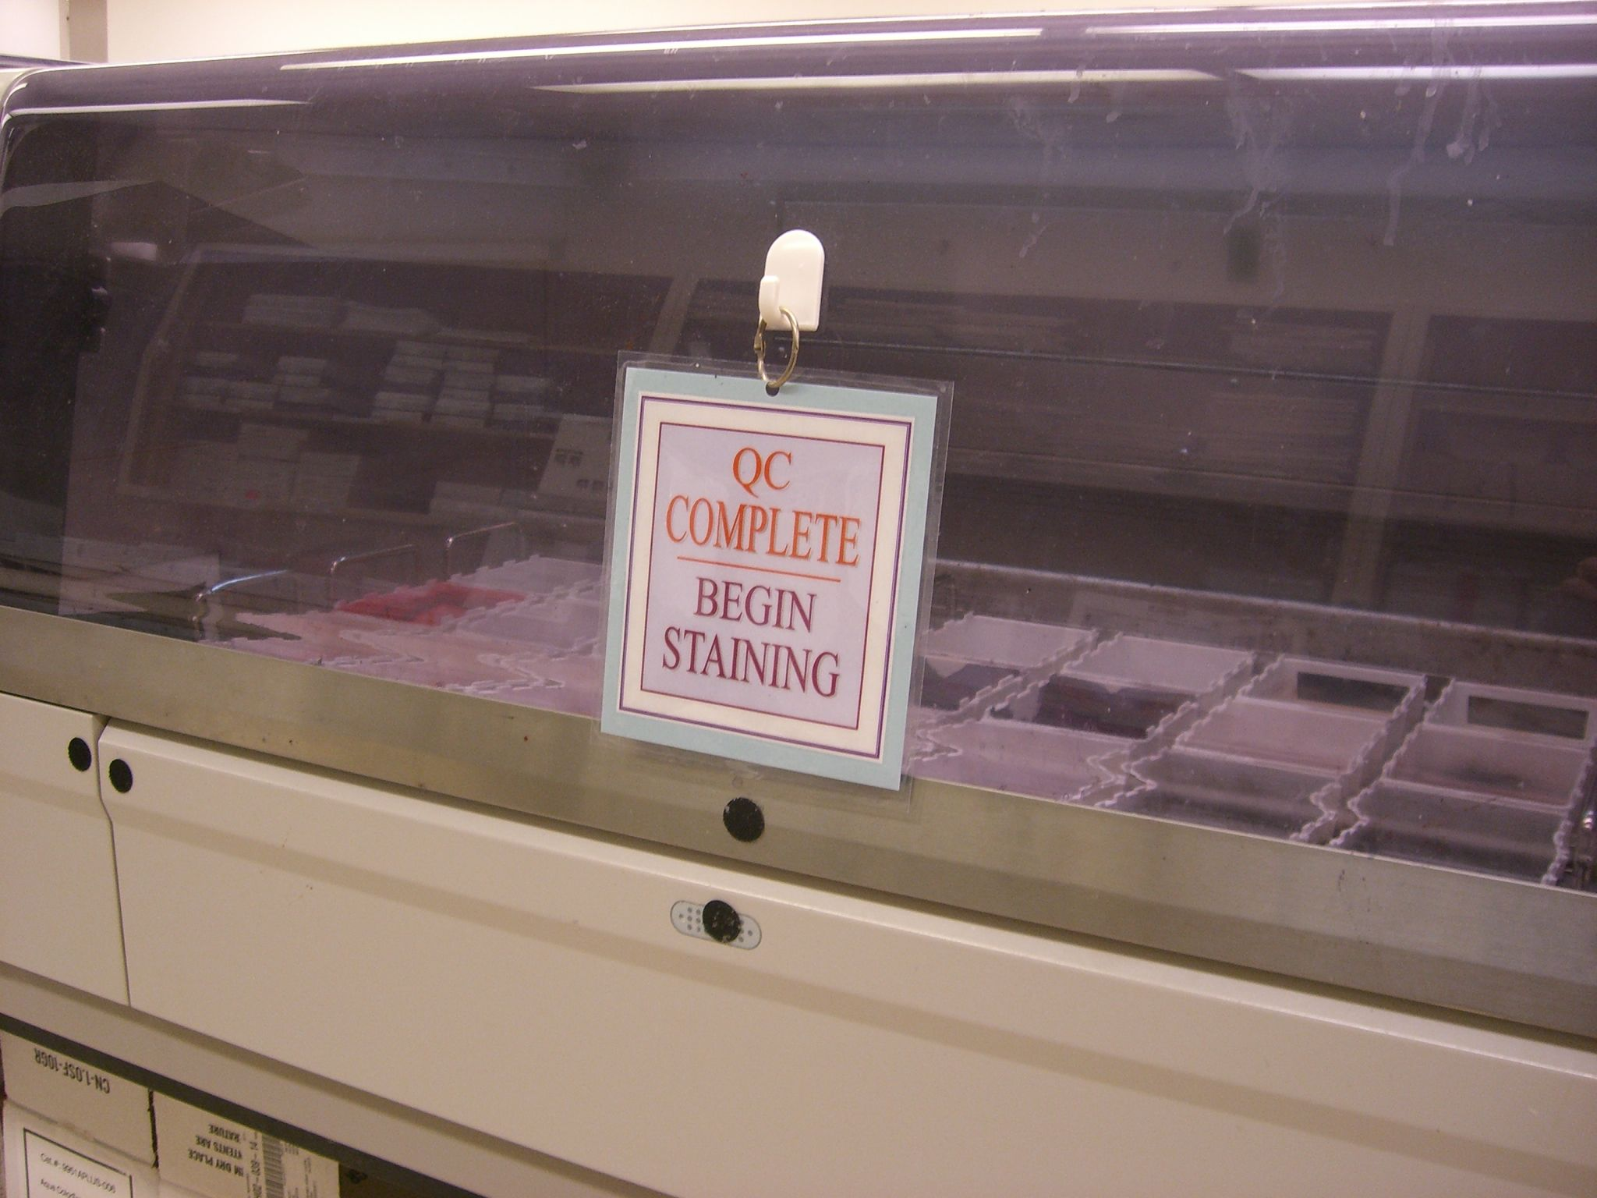
LARC Workbook

Slide 46
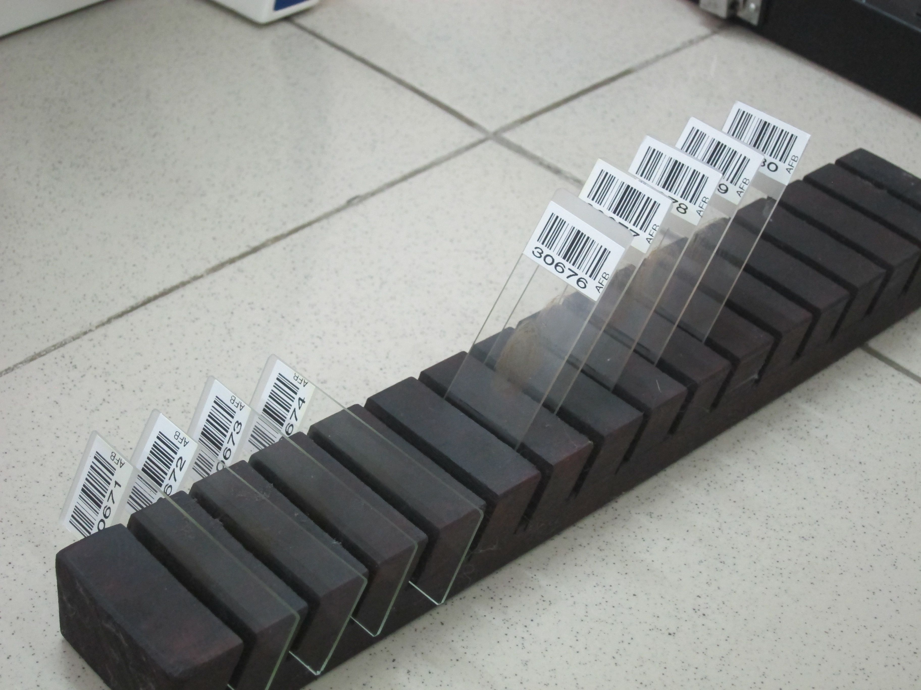
LARC Workbook

Slide 47

LARC Workbook

Slide 48
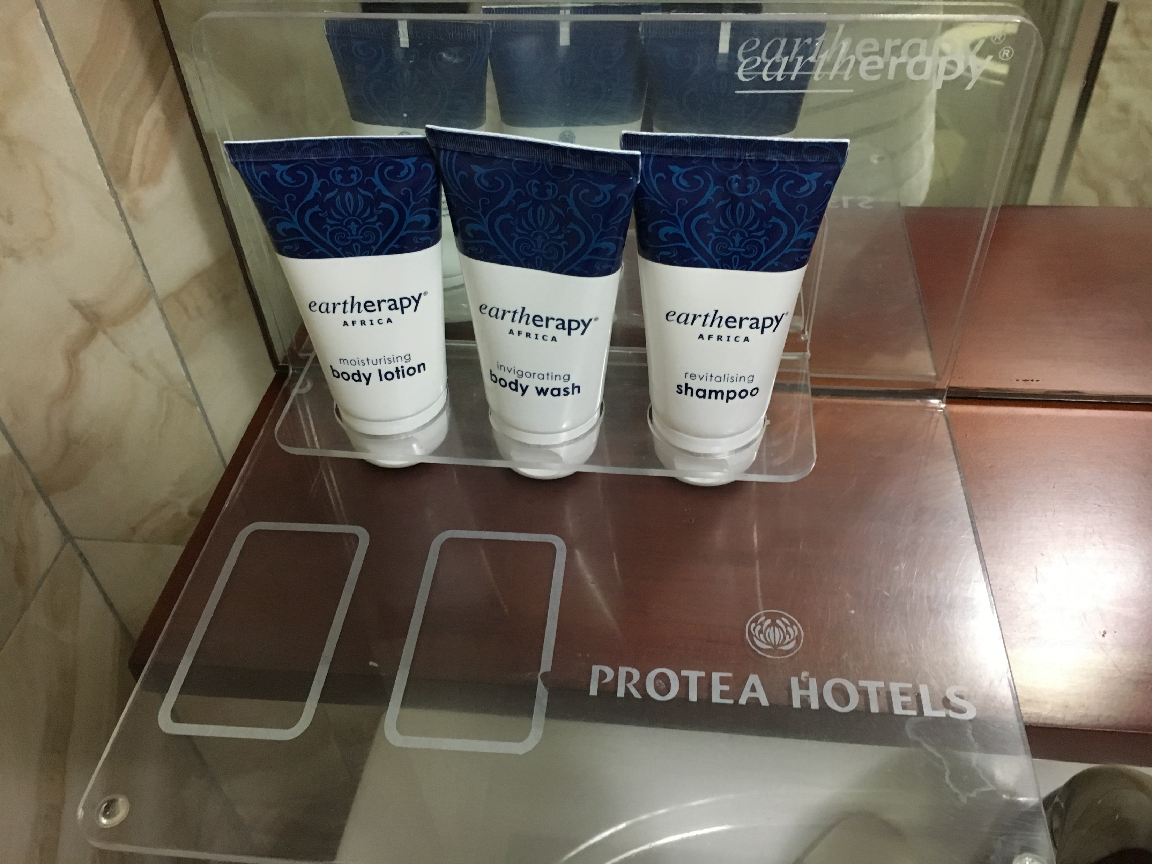
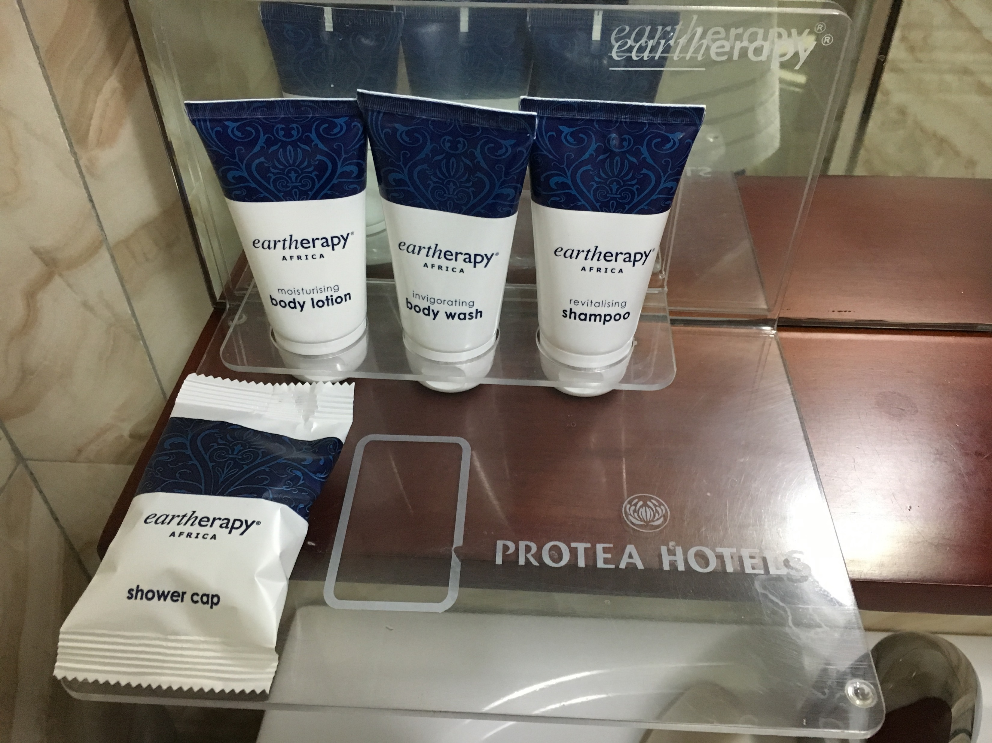
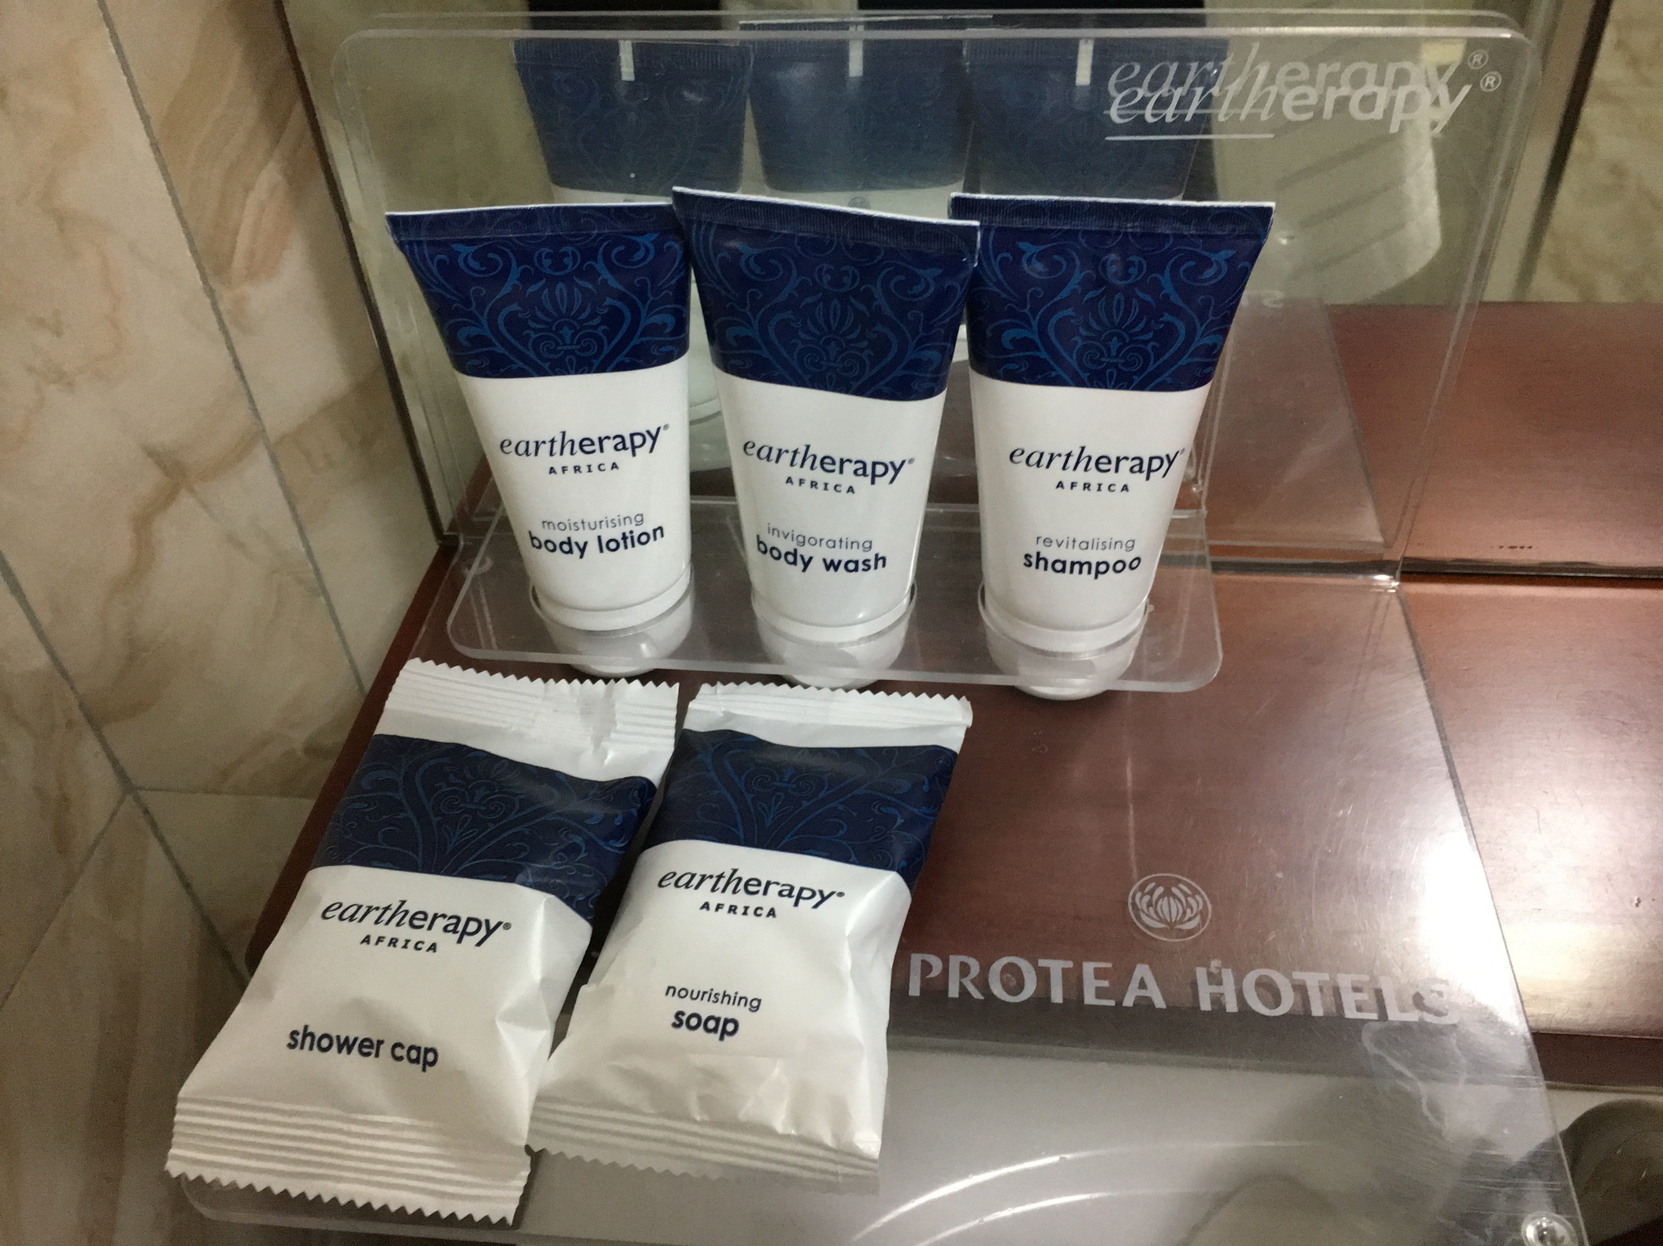
LARC Workbook

Slide 49
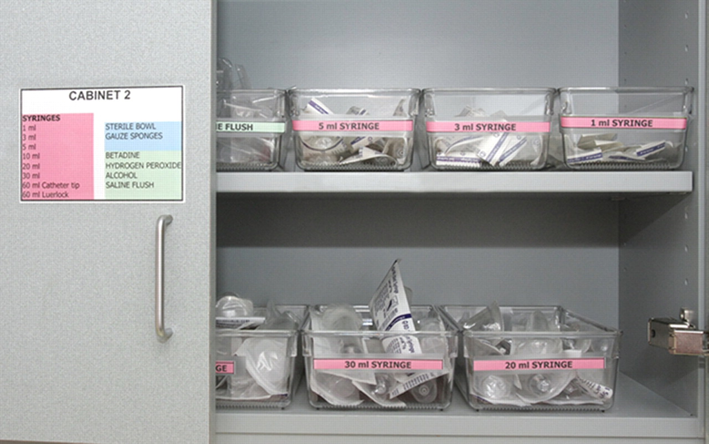
LARC Workbook

Slide 50
Let’s talk about standardization…
How important is standardization to implementing improvement?
LARC Workbook, p. 76
https://www.larccqi.org/uploads/resources/LARC-3.0-WORKBOOK.pdf
LARC Workbook

Slide 51
Activity
What you will need:
Piece of paper
Volunteers
Standardization (working with instruction)
Given a piece of paper to fold
Follow the instruction
When time is up, stop
Compare the results of the volunteers
Debrief
15 minutes
LARC Workbook

Slide 52
Work Instructions
"This exercise requires listening to and following directions. As you hear the oral instructions, perform the requested task.
1. No one may ask questions during this activity.
2. You may use only the materials given to you for the exercise.
3. Do not look at someone’s work
4. Fold your sheet of paper in half.
5. Tear off the upper right-hand corner.
6. Fold your paper in half again.
7. Tear off the lower right-hand corner.
8. Fold your paper in half.
9. Tear off the upper left-hand corner.
10. Fold in half a ﬁnal time.
11. Tear off the lower left-hand corner.
12. Unfold your paper and hold it up.
13. Look at the product and compare it with the other participants’ products.
LARC Workbook

Slide 53
Standard Work
An important part of change
After you have:
  DEFINE - the problem
  MEASURE - Select a measure, collect baseline data & ongoing data
  ANALYZE – Find the root cause
  IMPROVE – Multiple PDCAs, Selected the change
Now, how do you make the change become standard work?
LARC Workbook, p. 76
https://www.larccqi.org/uploads/resources/LARC-3.0-WORKBOOK.pdf

Slide 54
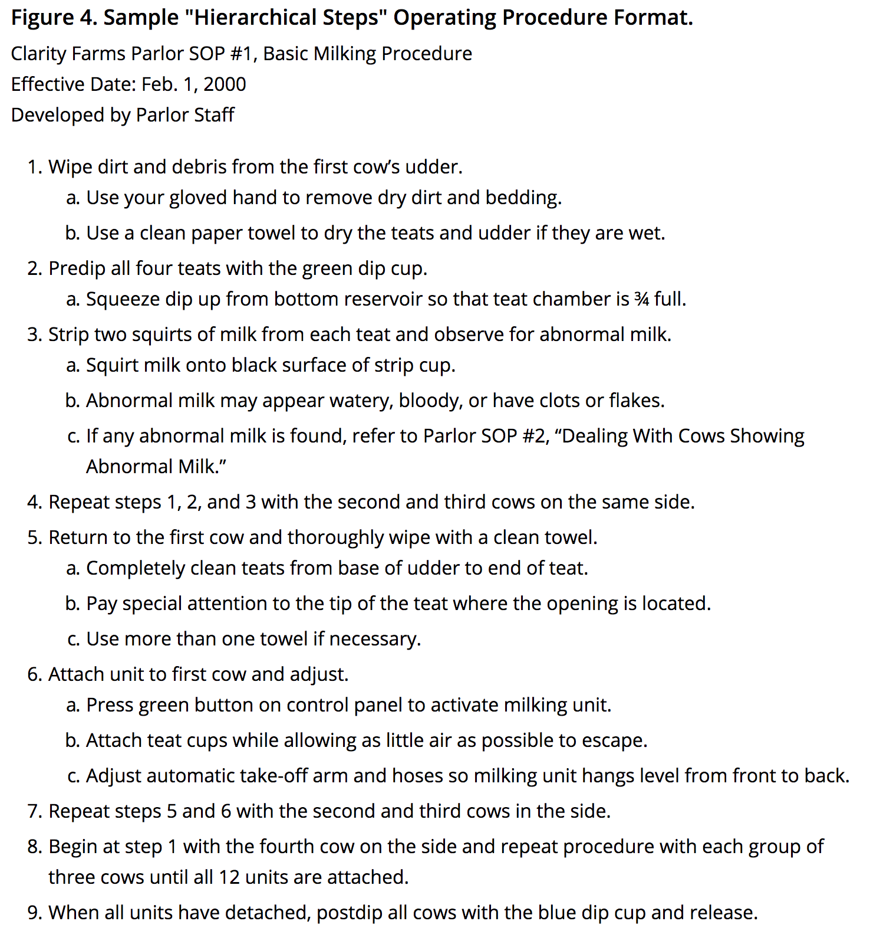

Communicating Standard Work
Simple or Hierarchical Steps
LARC Workbook

Slide 55
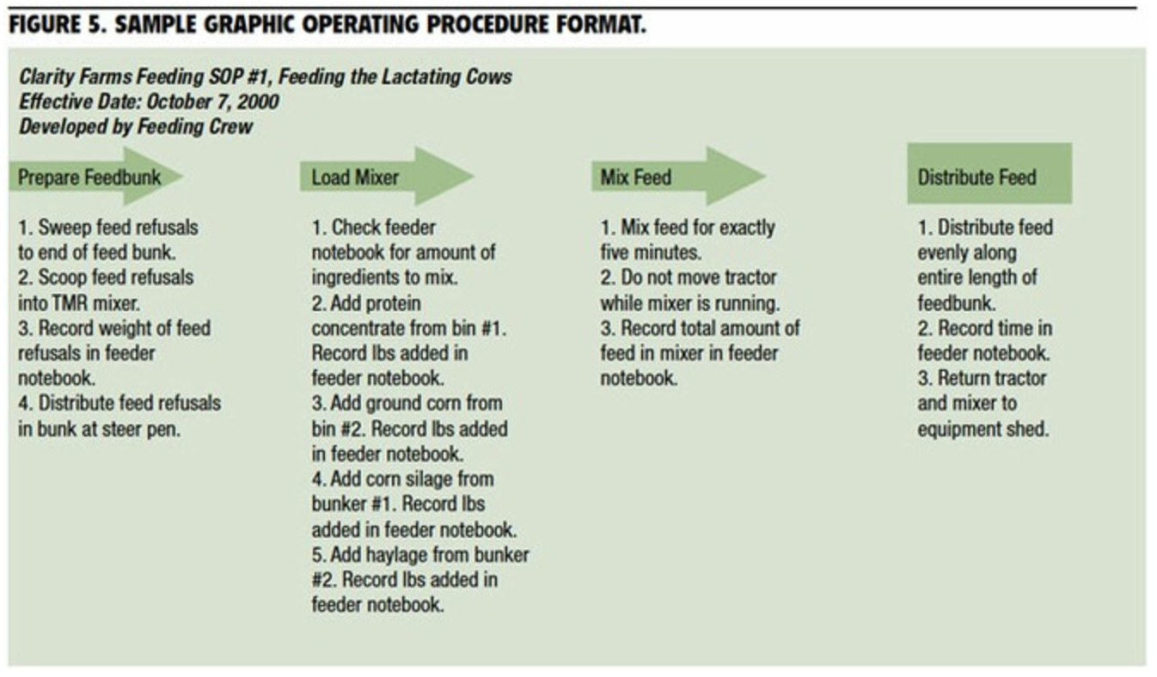
Communicating Standard Work
Graphic Procedures
LARC Workbook

Slide 56
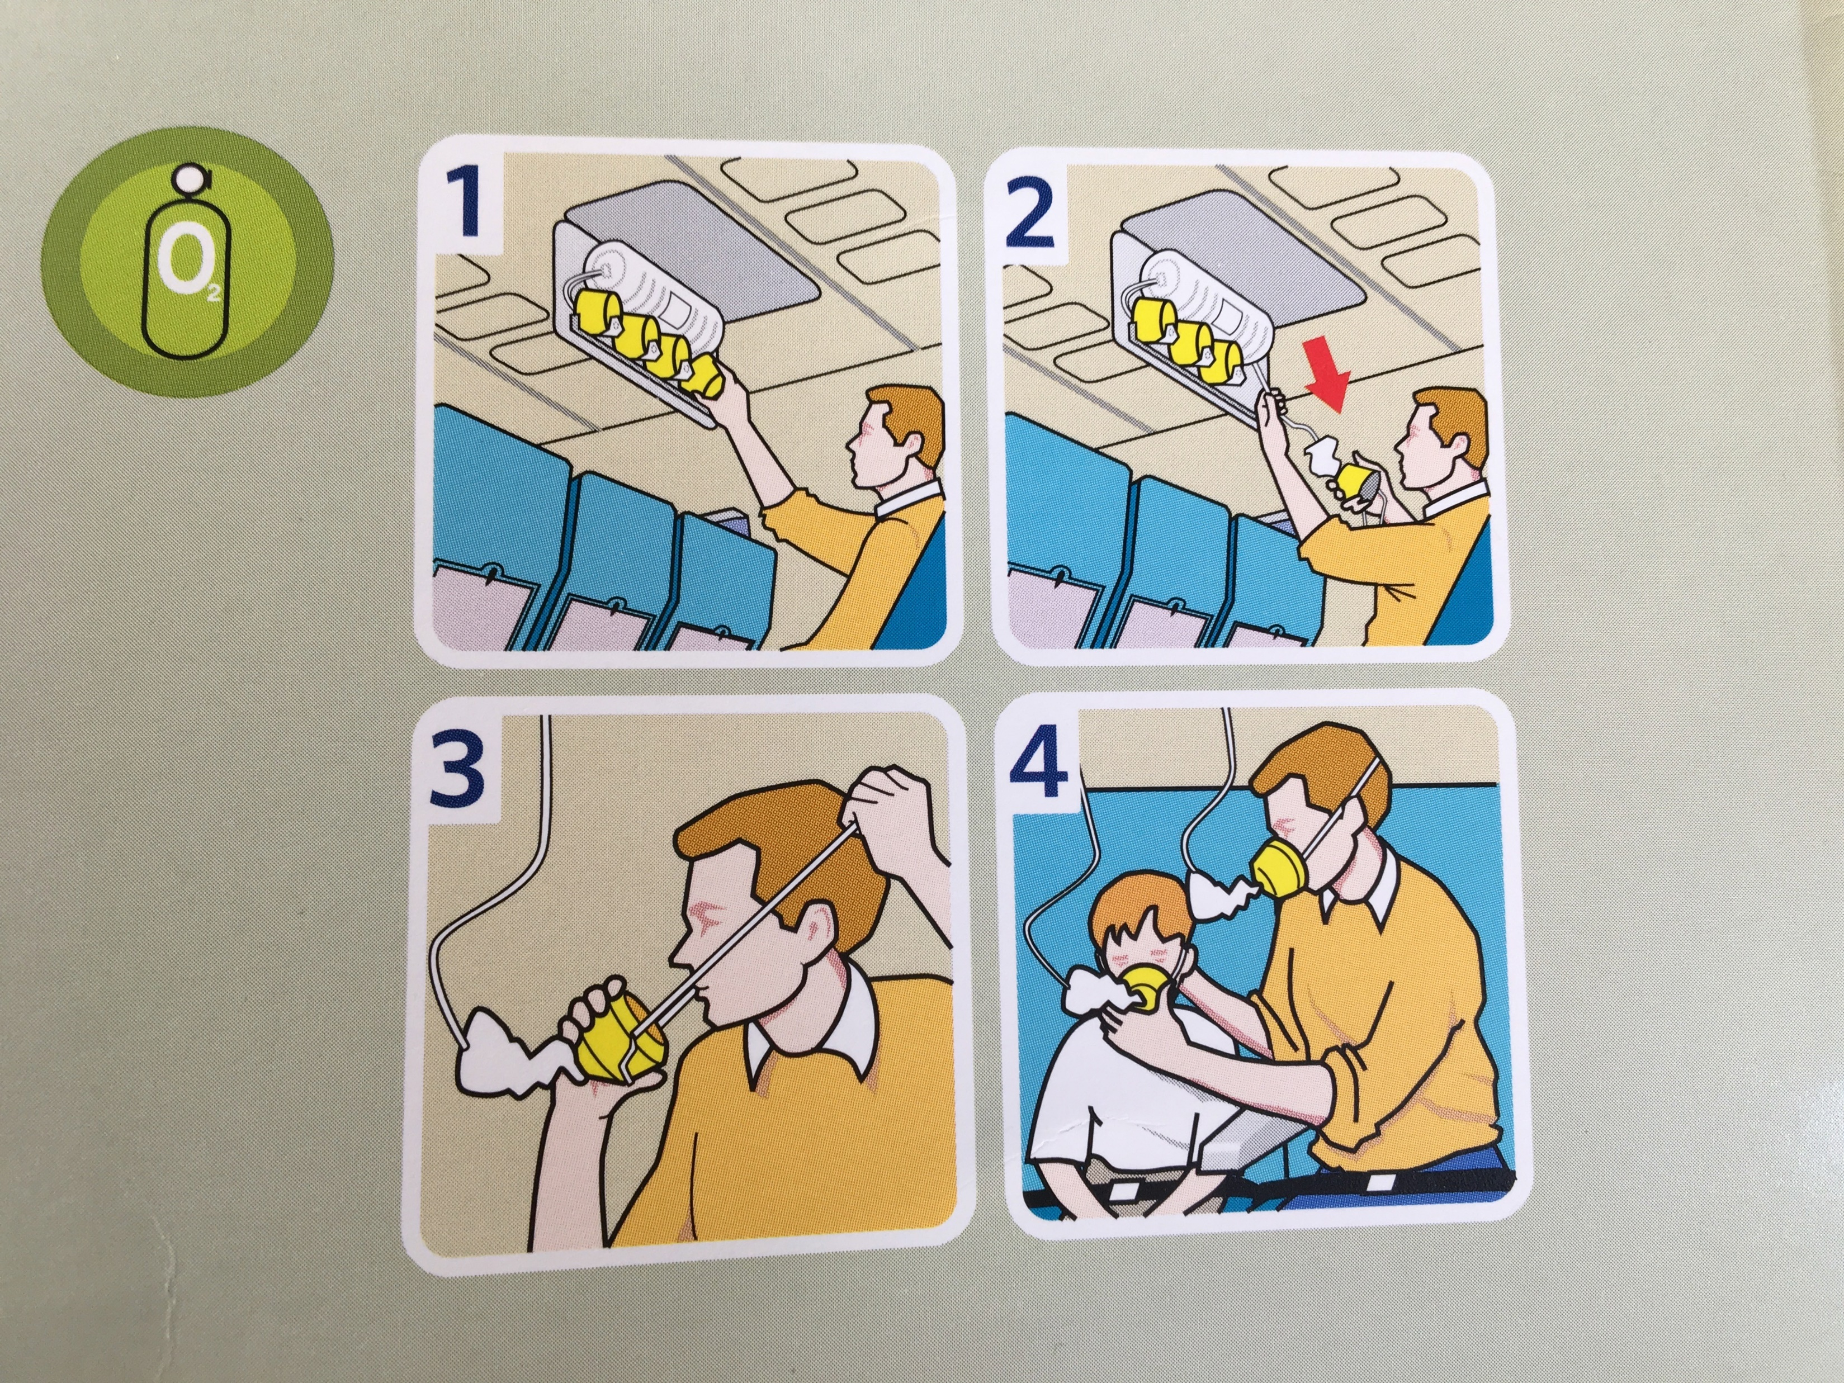
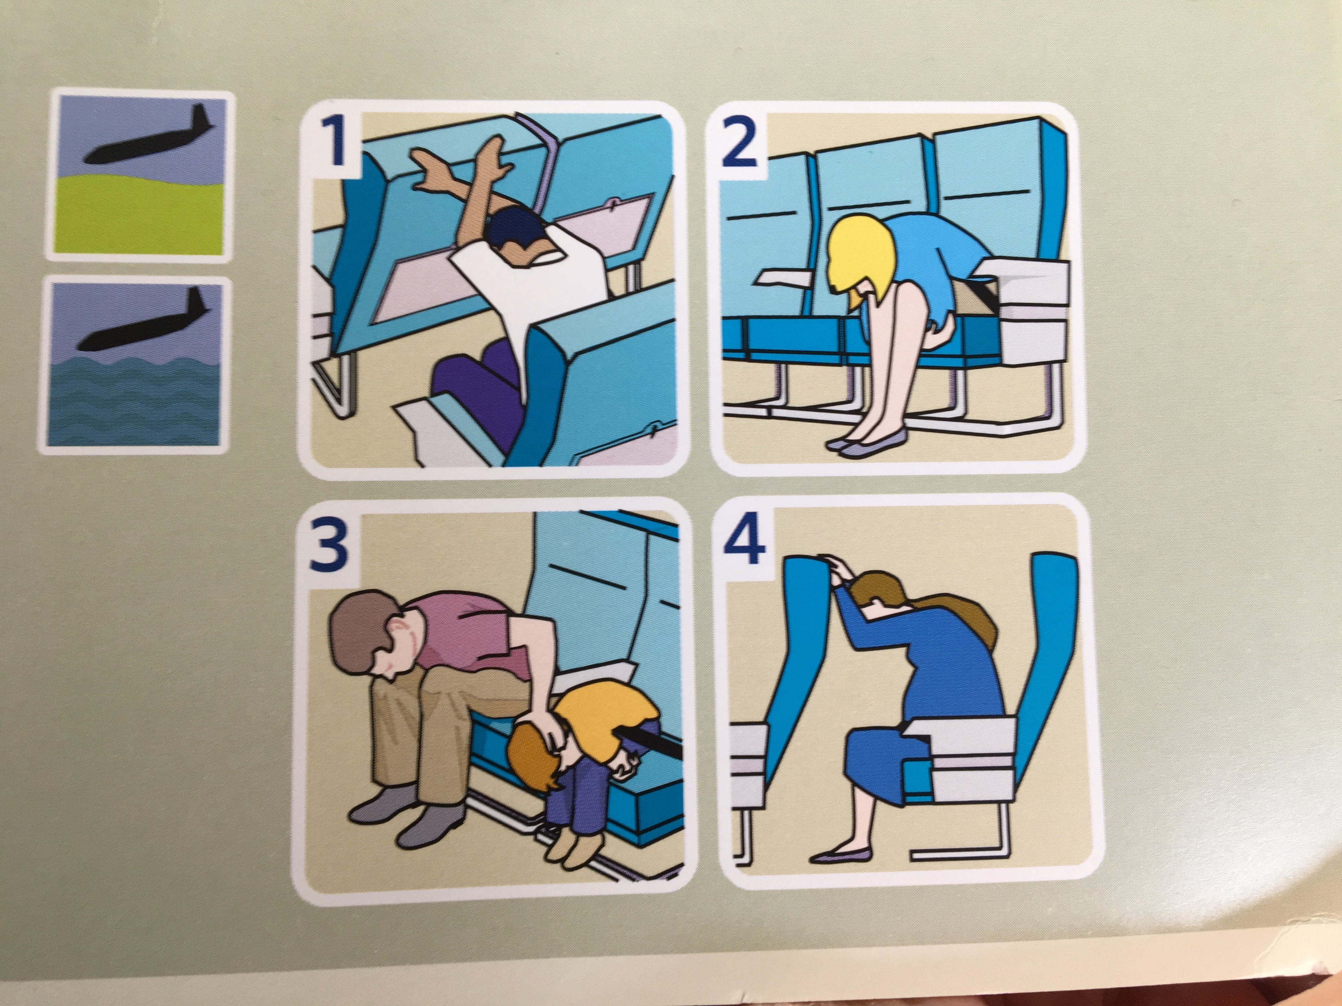
Communicating Standard Work Procedures: Graphic
LARC Workbook

Slide 57
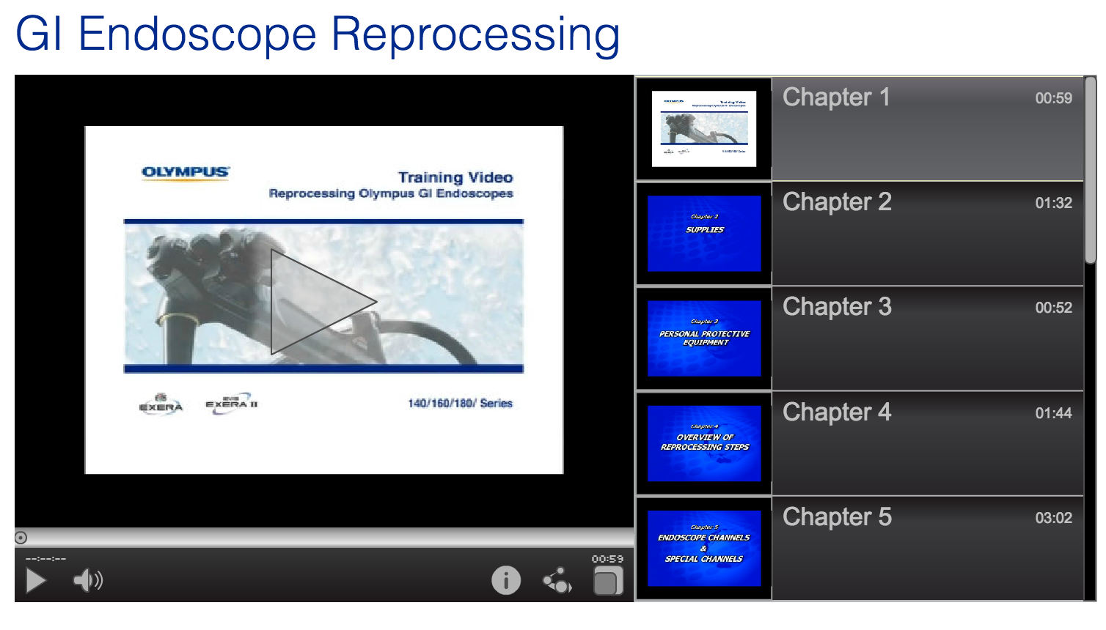
Communicating Standard Work Procedures: Video
LARC Workbook

Slide 58

Communicating Standard Work Procedures: Written Manual
111 Pages
LARC Workbook

Slide 59
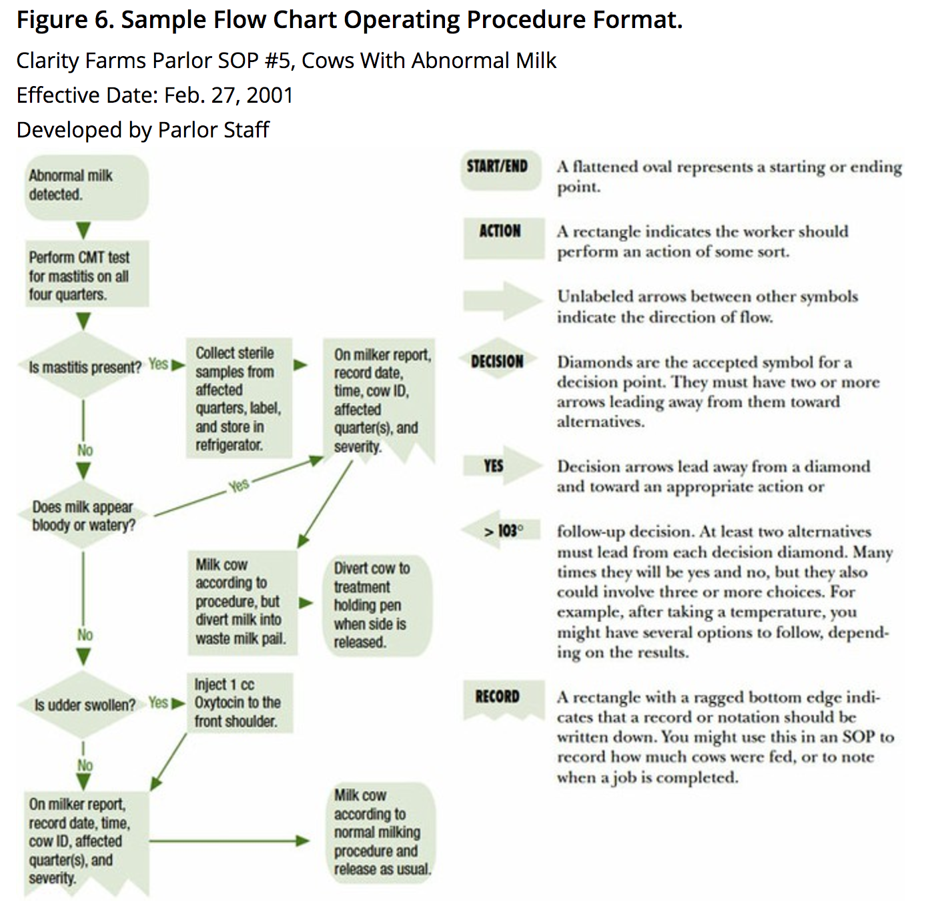
Communicating Standard Work Procedures: Flowcharts
LARC Workbook

Slide 60
Process Map – Future State
LARC Workbook, p. 38-41
https://www.larccqi.org/uploads/resources/LARC-3.0-WORKBOOK.pdf
LARC Workbook

Slide 61
Moving from Current State to Future State
Eliminate unnecessary steps
Combine steps when practical
Re-arrange steps for a better sequence
Simplify necessary steps
Work out your ideas with others
Create a new (future state) process map
LARC Workbook

Slide 62
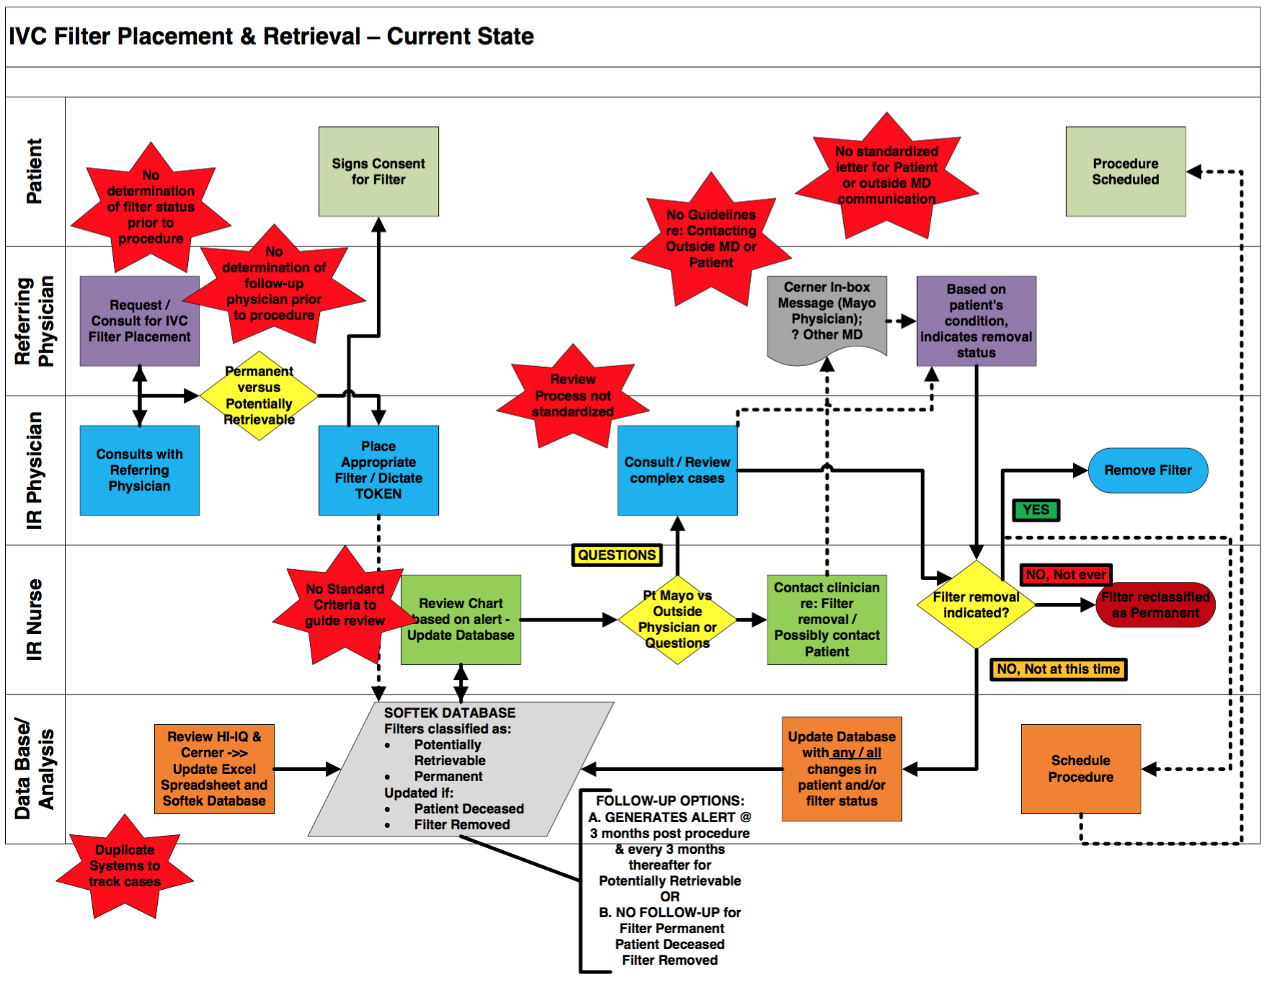
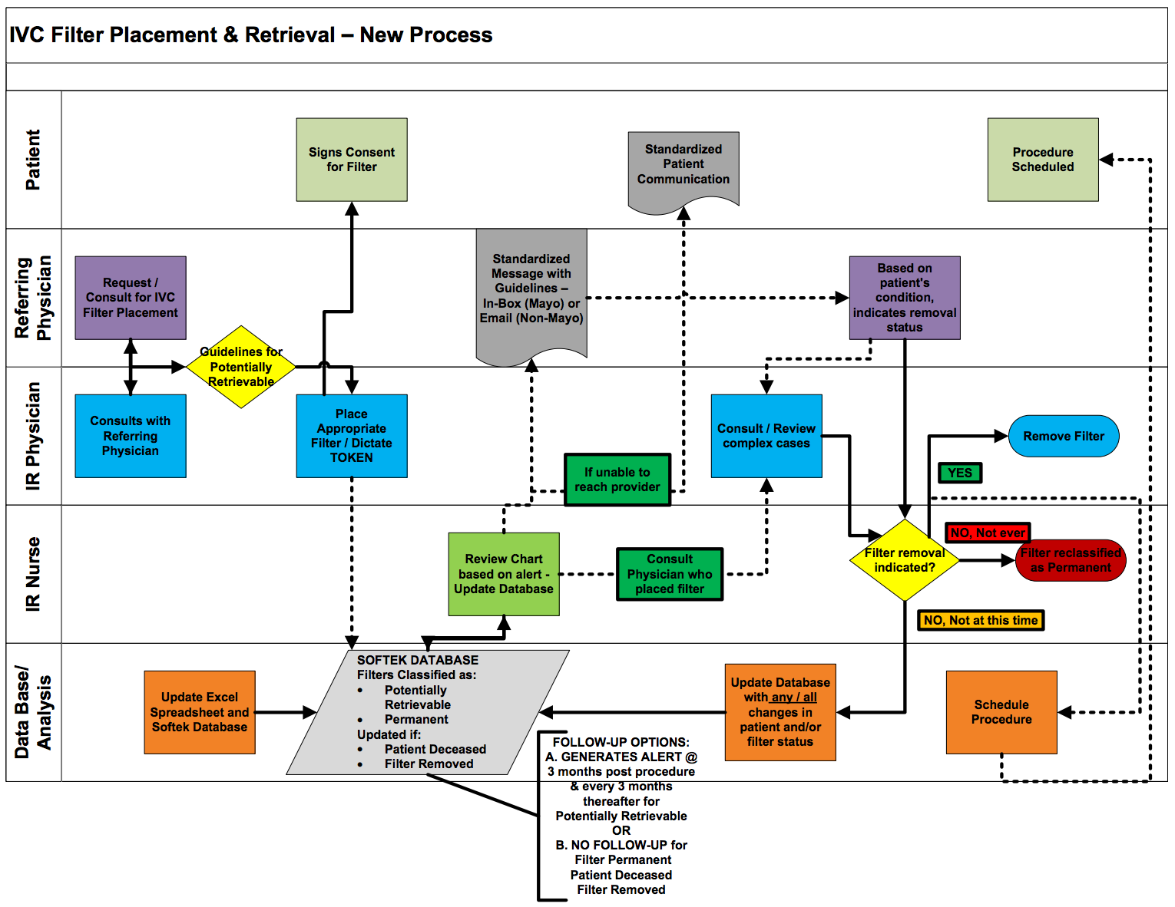
Communicating Standard Work- Process Maps
Current State
Future State
LARC Workbook

Slide 63
For Discussion
Why is standard work important?
When might you choose to use one form of communication of standard work over another?
LARC Workbook

Slide 64
Your Project Deliverables
Communicate your new process = your change = your standard work
  Create an SOP
    Simple or hierarchical steps
    Graphic procedures
  Create a future state process map
LARC Workbook

Slide 65
Armed with tools
Now Work on Your ED Flow Again
(Simulation Phase 2)

Slide 66
Things to Ponder…
Wastes that can be eliminated
PDSA may not be perfect first time
Combine responsibilities
Establish pull
No batching
Reduced distances and transport
What is critical to patient outcome
Better communication
Supplies at point of use
Ergonomics
Built in quality
Level workload
What is of value
Proper training and multiple competencies
Reduce patient and staff waiting
Visual indicators
LARC Workbook

Slide 67
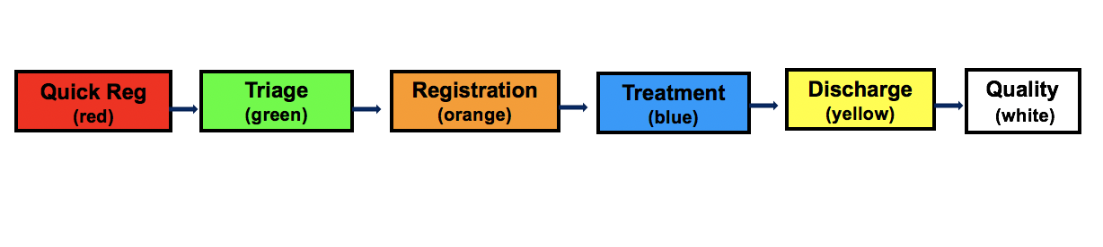
Simulation
LARC Workbook

Slide 68
Activity
What you will need:
Workstations
Tabletop signs
Work instructions
Patients
Timer
Registers
Paper sheets
Flip chart
Markers
Conduct an Emergency Department Simulation: Provide “care” to your “patients”
Redesign your process using the tools learned today
Goal: “Treat” as many patients as possible in the time given
Debrief with the group
30 minutes
LARC Workbook

Slide 69
Metrics
TEAM | # of Patients Treated (Completed) | # Treated “Correctly” | # Patients in Process | Time to First Patient Completed
1
2
3
LARC Workbook

Slide 70
Debrief – Phase #2
How did it go this time?
How were the outcomes?
Are there additional improvements you could make?
Was it easier?
Are good systems important?
LARC Workbook

Slide 71

LARC Workbook

Slide 72
Project Deliverables
Learning Session 2
IMPROVE
Update Project Outline, if necessary
1 5S Exercise
1 Visual Management Application
2 or more Tests of Change (PDSA)
  Select and Implement Change
Modify Solution(s) where necessary by additional Test of Change (PDSA)
Data Display
Create Future State Map
Create Standard Work
Presentation
LARC Workbook

Slide 73
Data Display
Project Learning Board
Creating a Run Chart
LARC Workbook, p. 55
https://www.larccqi.org/uploads/resources/LARC-3.0-WORKBOOK.pdf
LARC Workbook

Slide 74
LEARNING BOARD
PROJECT |  |  | JUST DO IT
Aim / Metric | Changes |  | Identified Opportunities | Actions | Resolved
LARC Workbook, p. 16-17
https://www.larccqi.org/uploads/resources/LARC-3.0-WORKBOOK.pdf
LARC Workbook

Slide 75
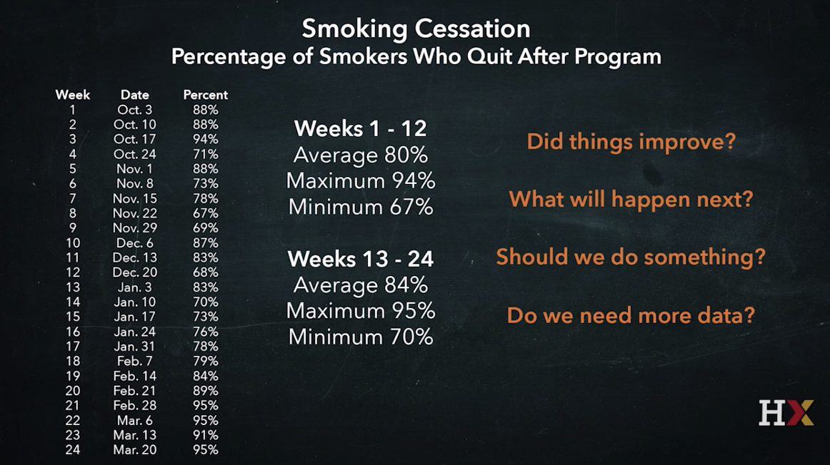
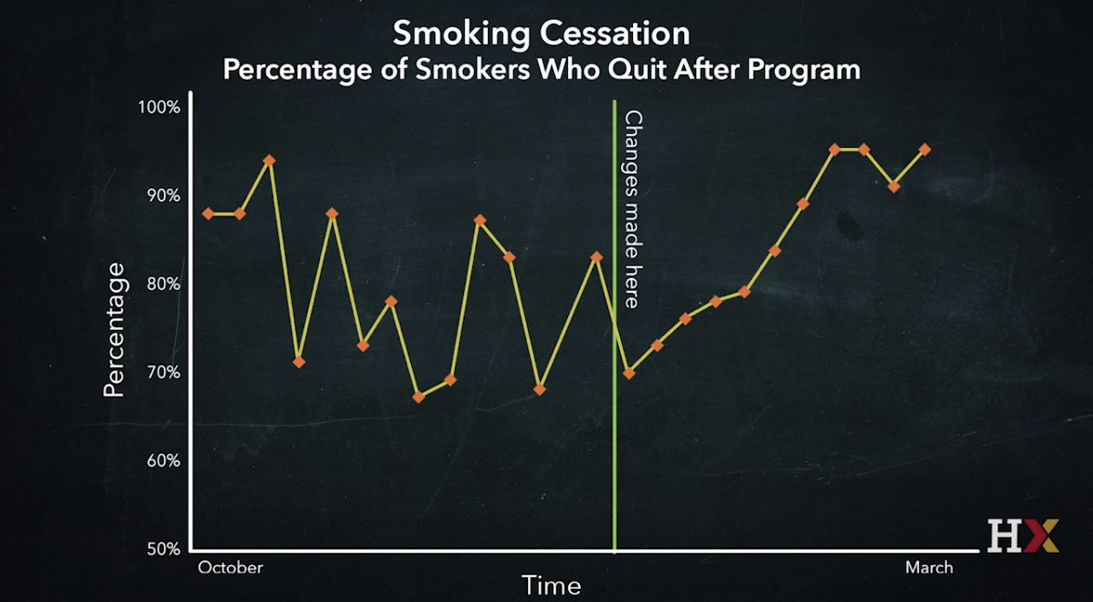
Learning from Data: Creating a Run Chart
LARC Workbook

Slide 76
Run Chart – WHY?
COMMUNICATION, COMMUNICATION, COMMUNICATION
  “Graphs tell a story”
Team Engagement
    Seeing where we are and where we want to be
    “Outcomes & goals that are not made visual will fail”
  Maintains focus
  “Friendly” competition
LARC Workbook

Slide 77
Activity: Data on number of TB patients screened
Month | Number of patients screened | Target: 60
January | 20
February | 25
March | 20
April | 25
May | 35
June | 50
July | 65
August | 64
September | 80
October | 90
LARC Workbook
Notes:
Say, “take a quick look at this data and tell me whether the number screened is increasing or declining?”
Is this data easy to “read”? Does it tell you clearly about screened patients? Is it visual? Is it impactful?

Slide 78
Activity
Create a “Run Chart”: Make the screening data visible and impactful
Given the data, create a run chart to communicate how the number has changed over time.
Display in front of classroom
Debrief with the Group
What you will need:
Sheet of paper
Ruler
Data
Creating a Run Chart: Tips
Pencils
15 minutes
LARC Workbook

Slide 79
Run Chart
LARC Workbook

Slide 80
Action Plan

Slide 81
Action Items Following LS #2
Action Items | By Whom? | By When?
Update LS#1 Deliverables: Project Outline, Process Map – add detail & circle focus for project, Fishbone – include “process” OFIs, Elevator Speech, Data Collection Log
Conduct Weekly Team Meetings
Update Learning Board and Project Outline
5S
Visual Management
PDSA #1…..PDSA #2…..more
Select and Implement Change
Modify Solution - Additional PDSAs
Data Display and Future State Map
Prepare for DiCE Follow-up Assessments

Slide 82
Questions?

